Slide 1
The role of disability, religion and belief in ethics of AI
Professor Jennifer George
Goldsmiths, University of London

Slide 2
Overview
Ethics committee membership
Disability models
  Role of AI
Religion and belief
  Role of AI
Ethics structure (legislation)
Questions we can raise

Slide 3
Who is an academic?
Left leaning
Labour voting
No faith / religious belief – or belong to the ‘right’ religion
Believe the same thing about BAME
Dare not say anything different!

Slide 4
Who are the members of Ethics Committees?
Academics!
The membership is homogenous
Similar views (if different, don’t say it)
No ToR for ethics committees or frameworks
Legal issues led vs. genuine debate

Slide 5
What guides ethics?
Data protection
Privacy
Legislation
  Who is responsible for monitoring
  What is the responsibility of media – do they communicate responsibly and realistically?
  Can AI help and would this lead to replacing humans?
Equality of access
Realistic expectations and limitations
Notes:
This is all good but quite legalistic

Slide 6
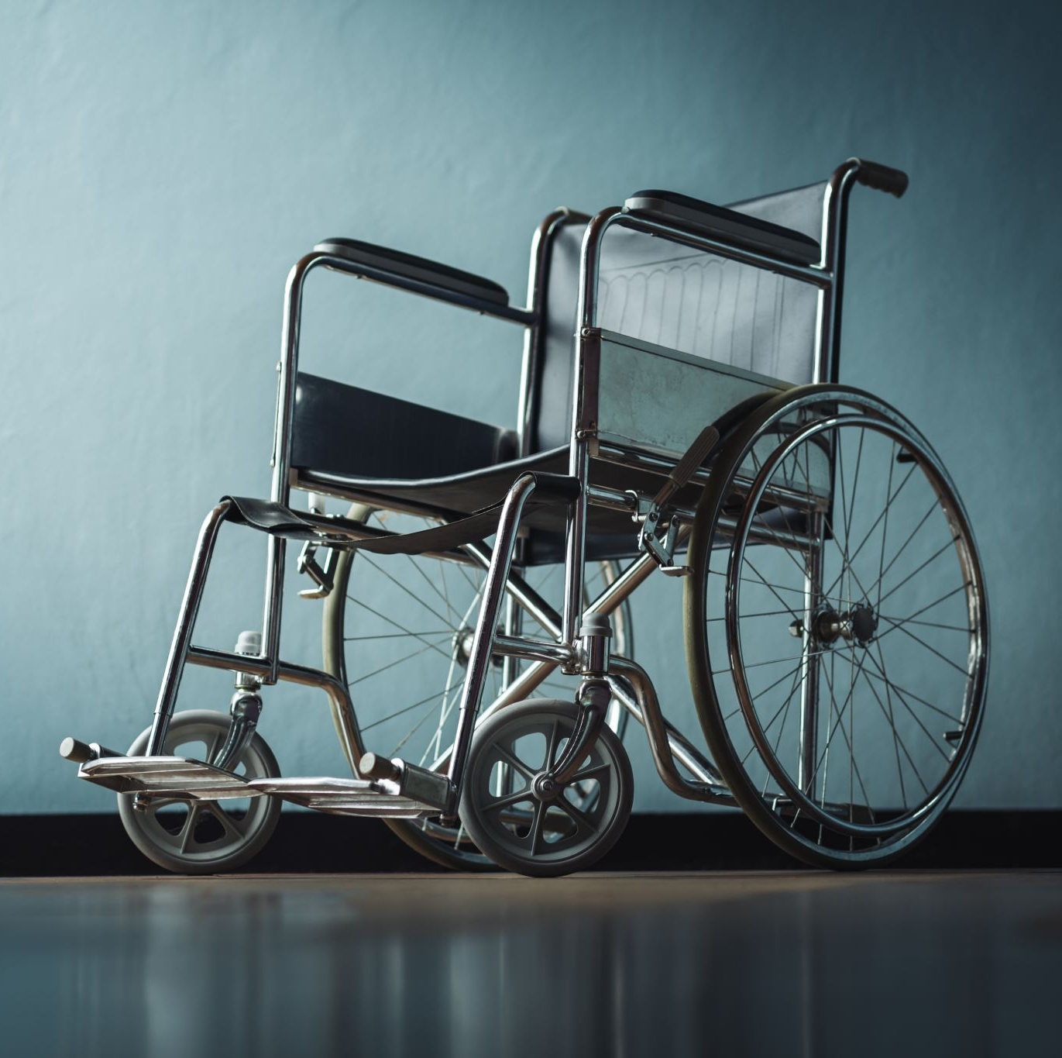
Medical Model of Disabilities (Local Authority websites)
People are disabled by their impairments or differences.
These impairments or differences should be ‘fixed’ or changed by medical and other treatments, even when the impairment or difference does not cause pain or illness.
Looks at what is ‘wrong’ with the person and not what the person needs/context.
Creates low expectations and leads to people losing independence, choice and control in their own lives.

Slide 7
Social Model of Disability (Local Authority websites)
Disabled people developed the social model of disability because the traditional medical model did not explain their personal experience of disability or help to develop more inclusive ways of living.
Disability is caused by the way society is organised, rather than by a person’s impairment or difference.
It looks at ways of removing barriers that restrict life choices for disabled people.
When barriers are removed, disabled people can be independent and equal in society, with choice and control over their own lives.

Slide 8
How does AI help those with Disabilities?

Slide 9
Examples of AI removing barriers
Vision
  Google Lens
    Mainstream product, ask for object and text recognition using camera
  Be My AI
    Extension to Be My Eyes where 60% of items are identified by AI
Hearing
  Ava/ RogerVoice
    AI based captioning and translation to transcribe group conversations in real time, text-to-speech including correcting regular words from friends and family
  Signapse
    AI based real time signing software

Slide 10
Communication
Speech recognition
Google
  Project Euphonia/Relate – AI used to improve speech recognition models for eg. speech disabilities like cerebral palsy or tricky English accents
Alexa / Siri / Google
Google Lens – using AI for visual search

Slide 11
Vision
Be My Eyes (https://www.bemyeyes.com/)
  Danish App that connects blind and low vision users with 3.5million volunteers across the world to identify products
Be My AI
  Extension to Be My Eyes where 60% of items are identified by AI
Seeing AI
  By Microsoft – narrates the world around you
Google Lens
  Mainstream product, ask for object and text recognition using camera
Notes:
Recognizes barcodes, QR codes, things, handwriting, text

Slide 12
Hearing
Ava/ RogerVoice
  AI based captioning and translation to transcribe group conversations in real time, text-to-speech including correcting regular words from friends and family
HeardThat
  Filtering out background noises using a range
Orka Two
  AI powered hearing aid; continuously balanced noises with choice of retaining background noise
Signapse
  AI based real time signing software

Slide 13
Communication
Google
  Project Euphonia/Relate – AI used to improve speech recognition models for eg. speech disabilities like cerebral palsy or tricky English accents
  Project Parrotron – does the above but adds text to speech
  Project relate – improving understanding of non-standard speech

Slide 14
Cognitive / Learning
Alexa / Siri / Google
Google Lens – using AI for visual search
Helpicto (French only) – turns text to images
Goblin Tools – web service – AI powered To Do list by breaking down tasks and creating the list for you
Rabbit R1 – uses Large Action Models. Uses OpenAI, perplexity and Anthropic APIs. It learns how you interact with websites and apps and knows what buttons to click / forms to fill.
Notes:
https://bernardmarr.com/are-alexa-and-siri-considered-ai/

Slide 15
Other Brain Injuries
Self- driving / partially autonomous cars
Smart home technologies
  Smart plugs, lights, locks, kitchen appliances
  (short term memory)
Bots / digital assistance
  (Information processing difficulties)
Health data analysis for diagnostics

Slide 16

Other learning tools
ChatGPT
  Adaptation recommendations
Grammarly
  Helping with details
Alexa / Google
  Prompts, timers, radio

Slide 17
How does AI exclude disabled users (Part 1)
Fin Tech / Digital Finance – data based on disabled users. eg.
  Memory issues and carer control
  WCAG compliance
Recruitment
  Personality tests
  Facial disabilities
  Accessibility of tests
  Diversity of data
Notes:
https://blog.mondato.com/the-disabled-face-ai-driven-exclusion-despite-huge-market-potential/
https://cdt.org/wp-content/uploads/2020/12/Full-Text-Algorithm-driven-Hiring-Tools-Innovative-Recruitment-or-Expedited-Disability-Discrimination.pdf
https://www.td.org/atd-blog/why-ai-generated-art-is-missing-the-mark-for-people-with-disabilities

Slide 18
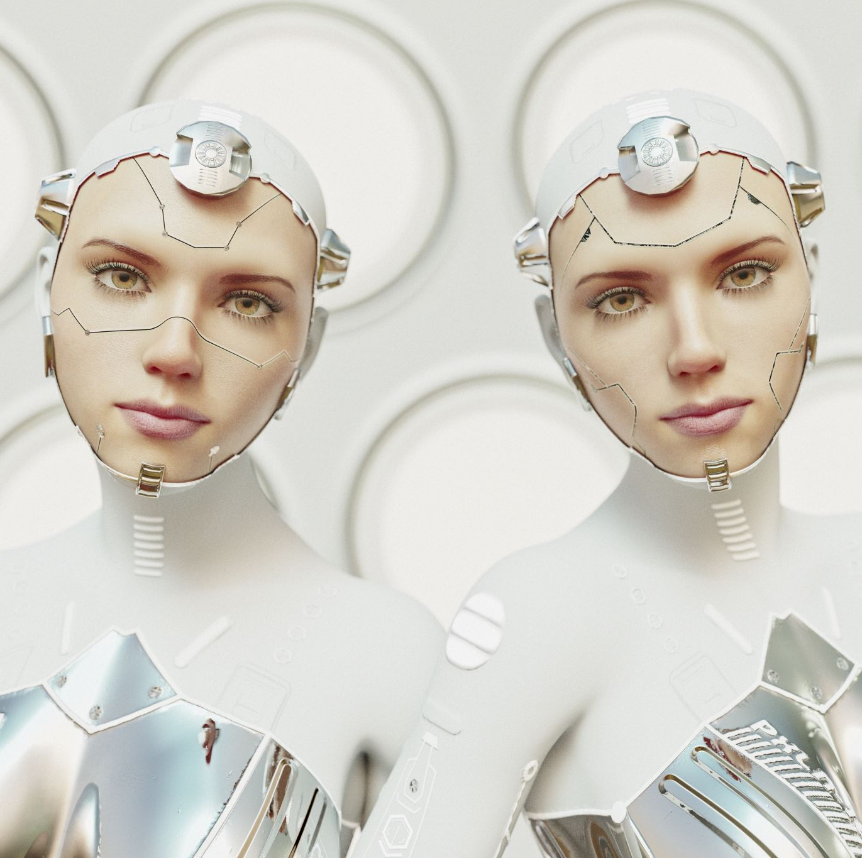
How does AI exclude disabled users (Part 2)
Generation of visual images of disabled
  Glamourized images eg. cybernetics vs. cochlear implants

Slide 19
Bias vs. Discrimination
Bias is built unconsciously or consciously from experience (human) or data (AI)
Discrimination is what results from bias

Slide 20
How has AI impacted religion (examples)
Delivers sermons
Delivers religious teachings
Performs rituals
Takes confessions
Can provide companionship as a responsive statue
Notes:
BBC: God and robots: Will AI transform religion?

Slide 21
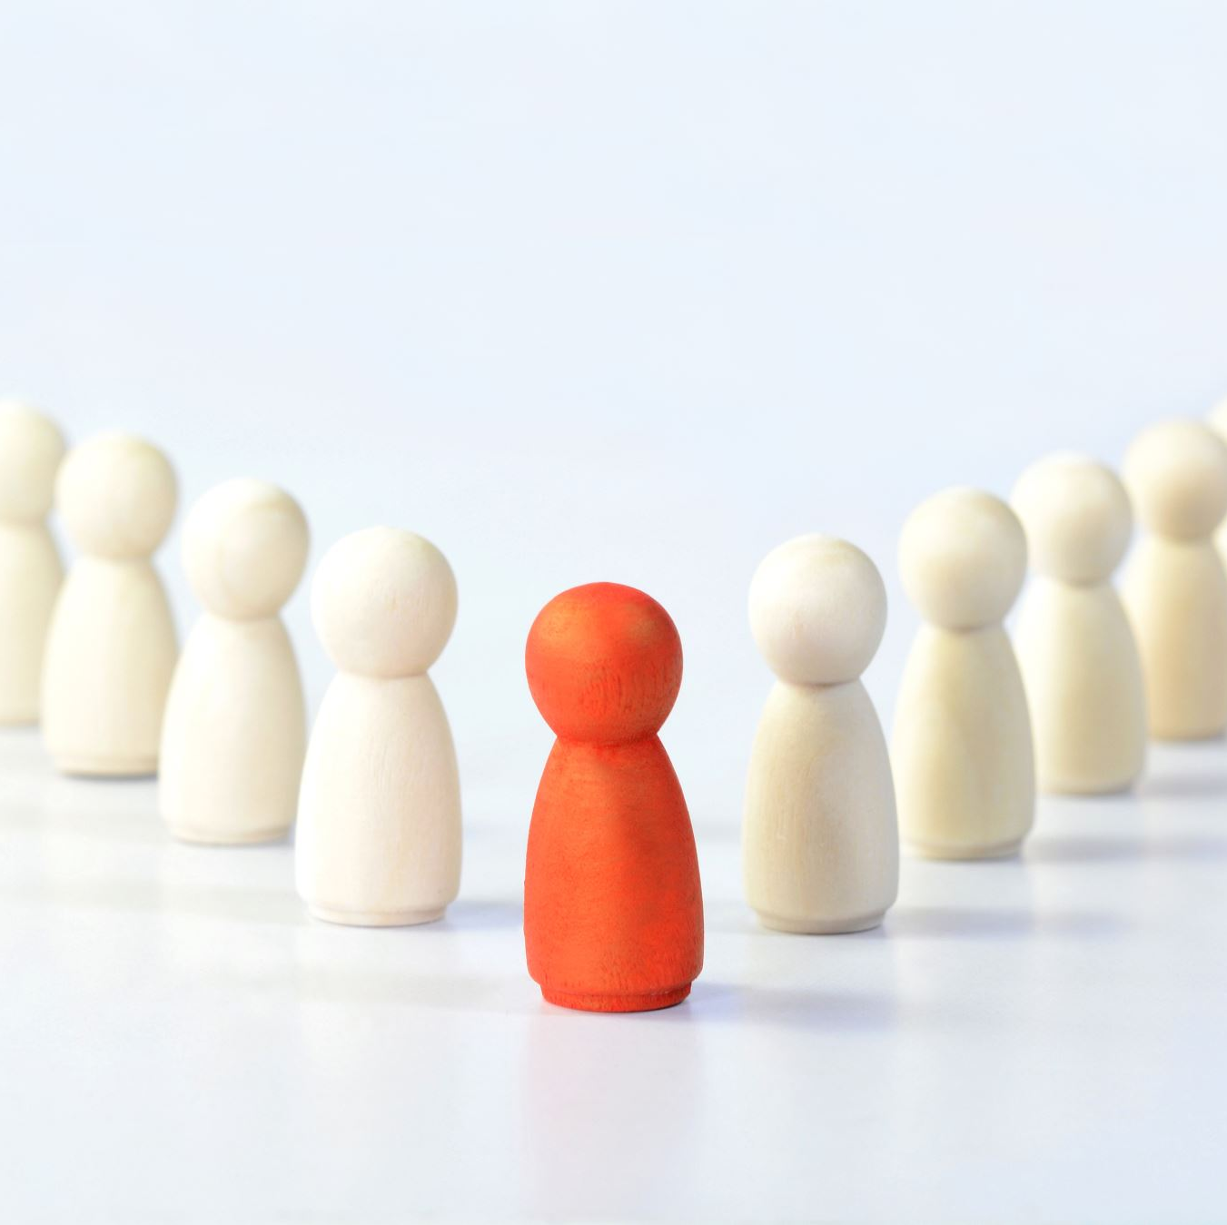
How does AI cause problems / discriminate against religion and belief
How the soul is perceived
The role of Gods replaced
Religious teachings are stepped on
Notes:
AI image of Buddha statue in a garden

Slide 22
Some definitions
Dis – false and misleading information with intent to deceive
Mis – false and misleading information with/without intent to deceive
Deepfake – is false and misleading information or image (with/without intent to deceive)

Slide 23
How AI impacts on political belief
Example: AI fake news / elections
Influences your views with with mis/dis information / deep fakes
Intersectionality (with disabled users)
  Those who cannot visually see the difference
  Those who are less ‘streetwise’ online
There are tools to help navigate
  Eg. www.ask-silver.com
Notes:
https://abilitynet.org.uk/news-blogs/dangers-ai-generated-fake-news-uk-general-election?utm_campaign=2766774_2024%20-%203%20July%20-%20News&utm_medium=email&utm_source=Charity_Digital&dm_i=3SCI,1NAUU,7QKBKE,6AYOW,1
https://www.bbc.co.uk/news/articles/c72ver6172do

Slide 24
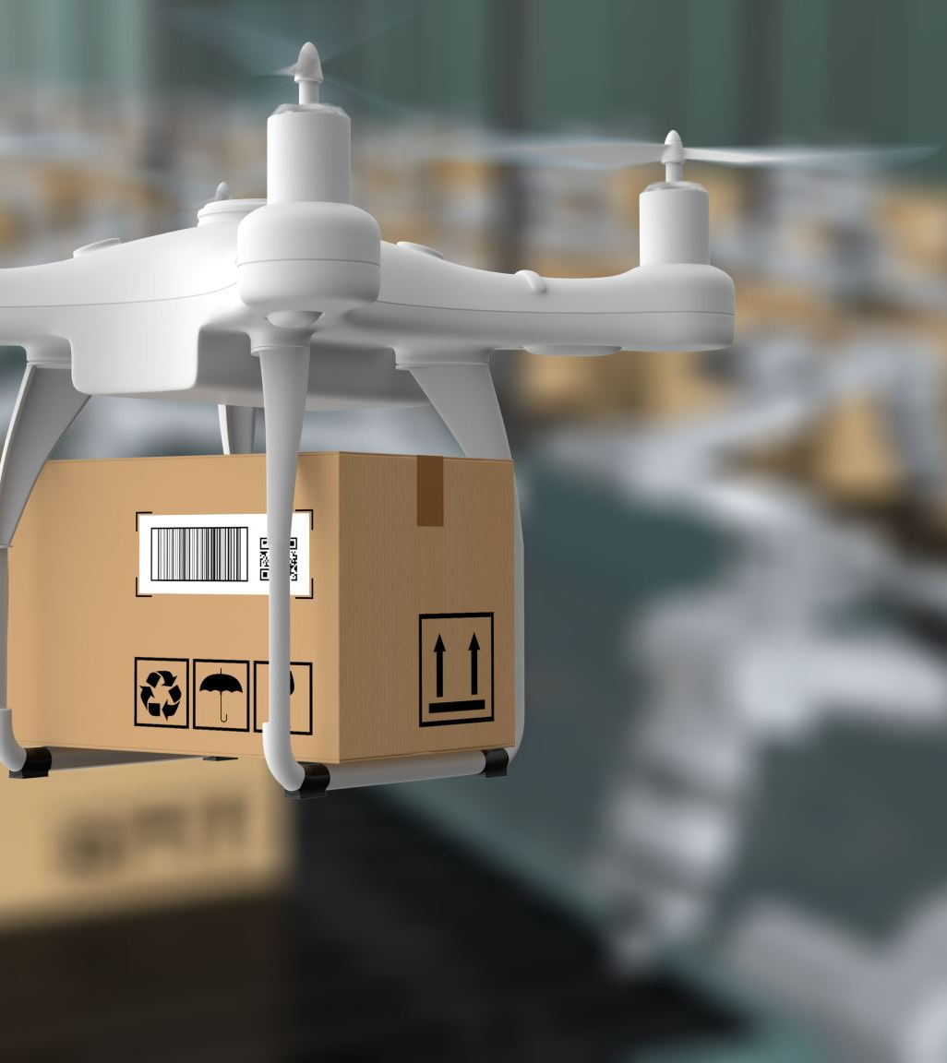
Drones in War
The AI informed drones in war
  Decision making
  Creation
  Power/agency we give AI
Notes:
https://www.theguardian.com/technology/article/2024/jul/14/ais-oppenheimer-moment-autonomous-weapons-enter-the-battlefield

Slide 25

Questions from religious perspective (Christianity)
“Love one another”
How does AI impact on our relationships?
What is our relationship with AI?
Criteria for relationships (embodiment)
  Relationships (placeholder for authentic relationship)
  Speak to and hear the other – communication (permission to use)
  Aid the other – agency – how much agency do we want to give / have?
  Do it gladly – can AI have emotions? It can recognize and analyse

Slide 26
Example: AI generated music
Music can be a relationship between collaborations
  Relationship between the instrument and the musician
  Musician to musician
What is AI’s role?
  AI doesn’t work in isolation (rarely)
  AI works with repository of huge number of artists

Slide 27
AI as Teachers
What makes teachers important?
  Emotional intelligence
  Empathy
AI has as much or more knowledge / information than teachers
Notes:
https://www.esparklearning.com/blog/can-ai-replace-teachers-we-finally-know-the-answer/#:~:text=Just%20as%20a%20calculator%20doesn,human%20expertise%20and%20technological%20support

Slide 28
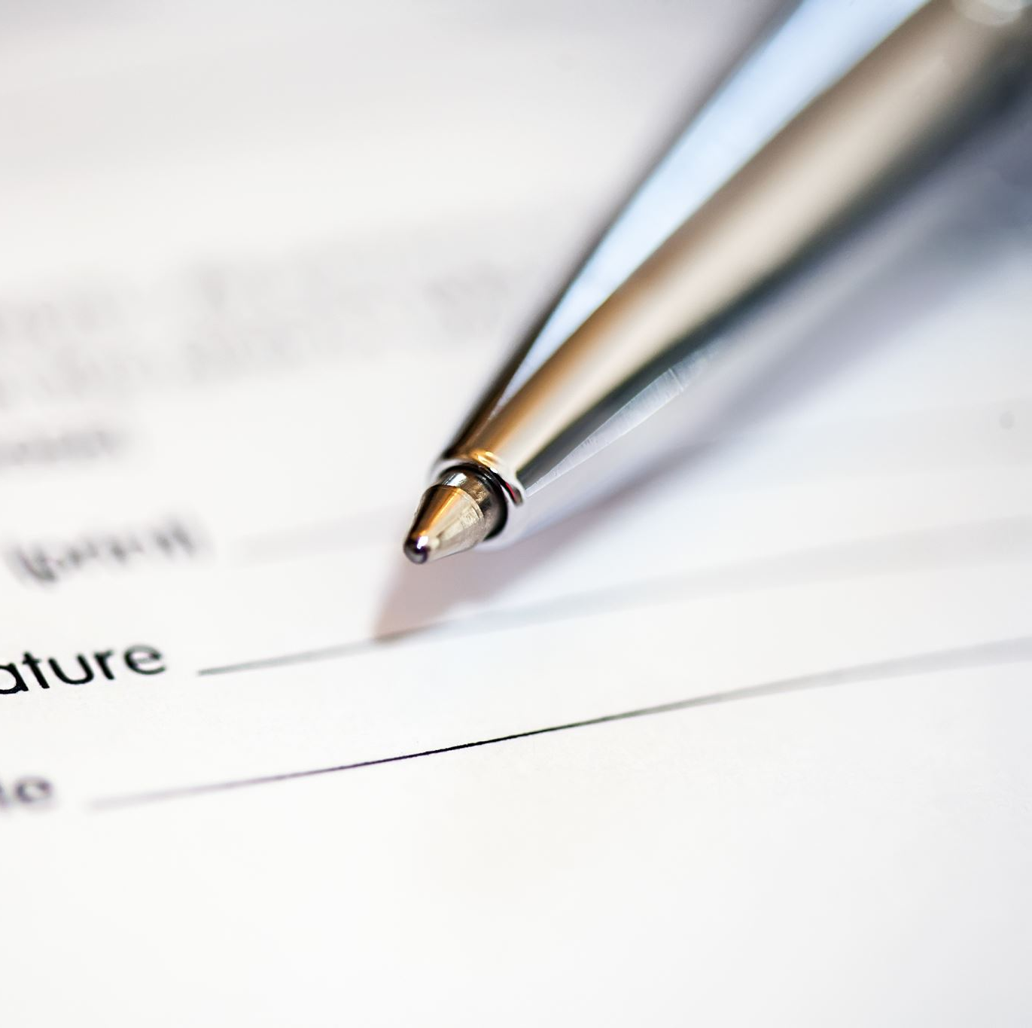
Other faith based questions
Programming something that hasn’t lived or not alive - creation
We are building for people and other living things - stewardship

Slide 29

Truth - importance
Truth is described as a way of life in many religions
Truth is a value in societies as a moral compass
Aims of deceit
  Financial gain
  Winning a war
Values of a society can be embedded in truth

Slide 30
Ethics - disability
23% of the working population in the UK is not in work
17% of us will gain a disability during our working lives
72% of productivity goes up when reasonable adjustments are made
AI can amplify human ability
AI can learn and get better

Slide 31
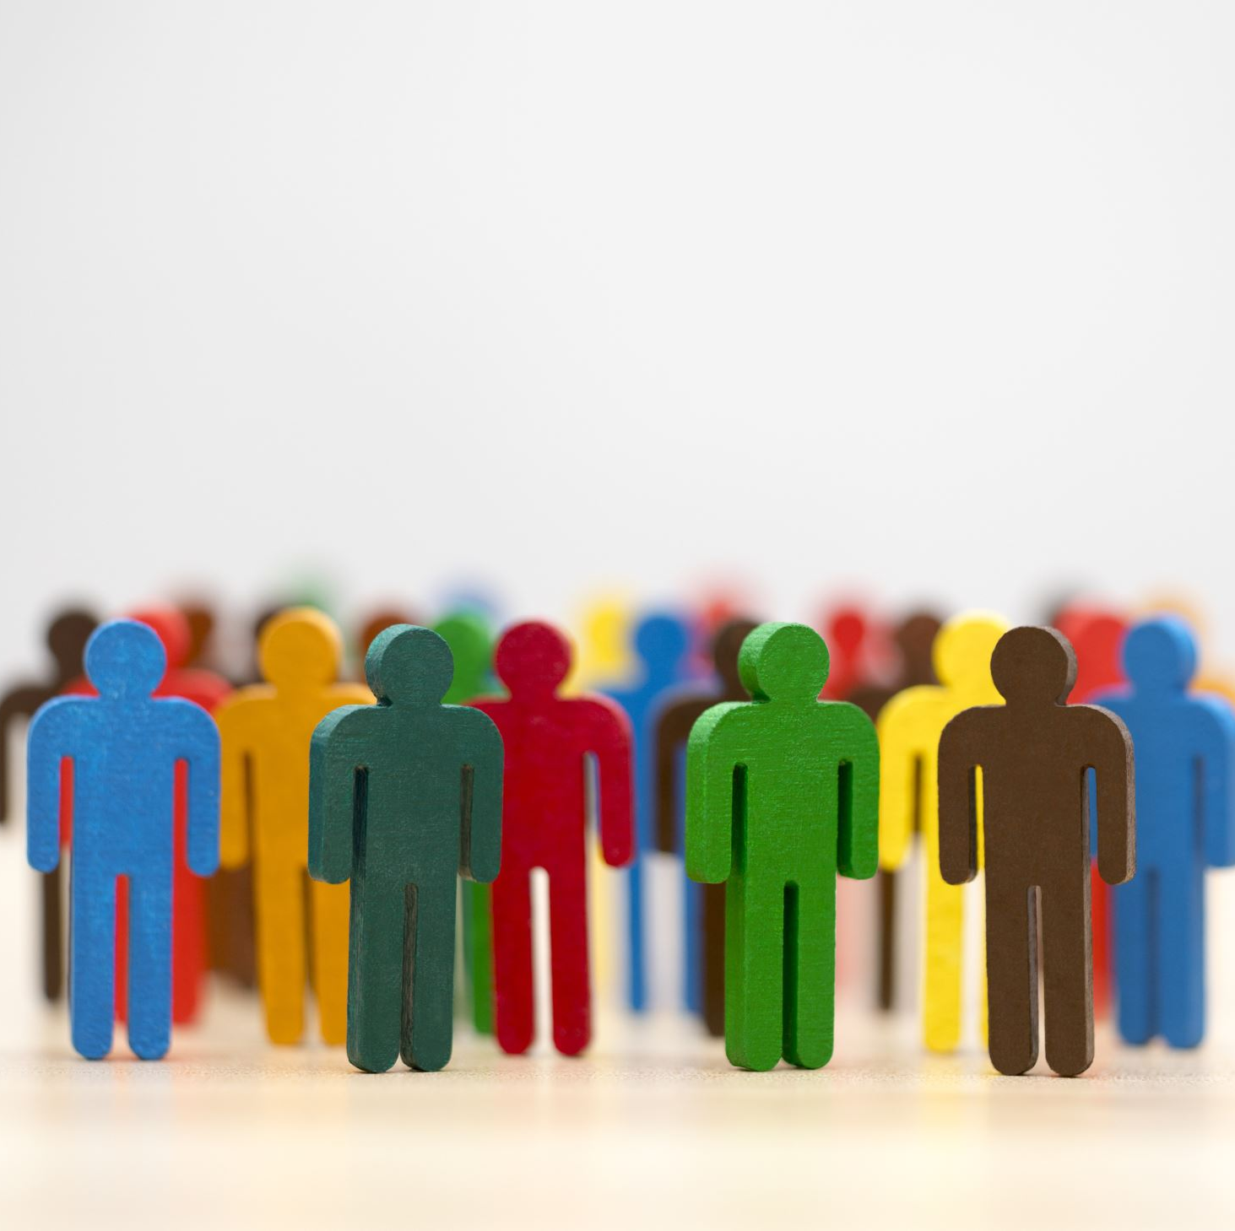
Legislation: Disability
Equality Act 2010
Public Sector Bodies Accessibility Regulation 2018
Down Syndrome Act 2022
European Equality Act 2024
Notes:
Private members bill

Slide 32

Legislation: AI
EU AI Act 2024
UK – a Private members bill went to House of Lords in March 2024 – is currently at 3rd reading

Slide 33
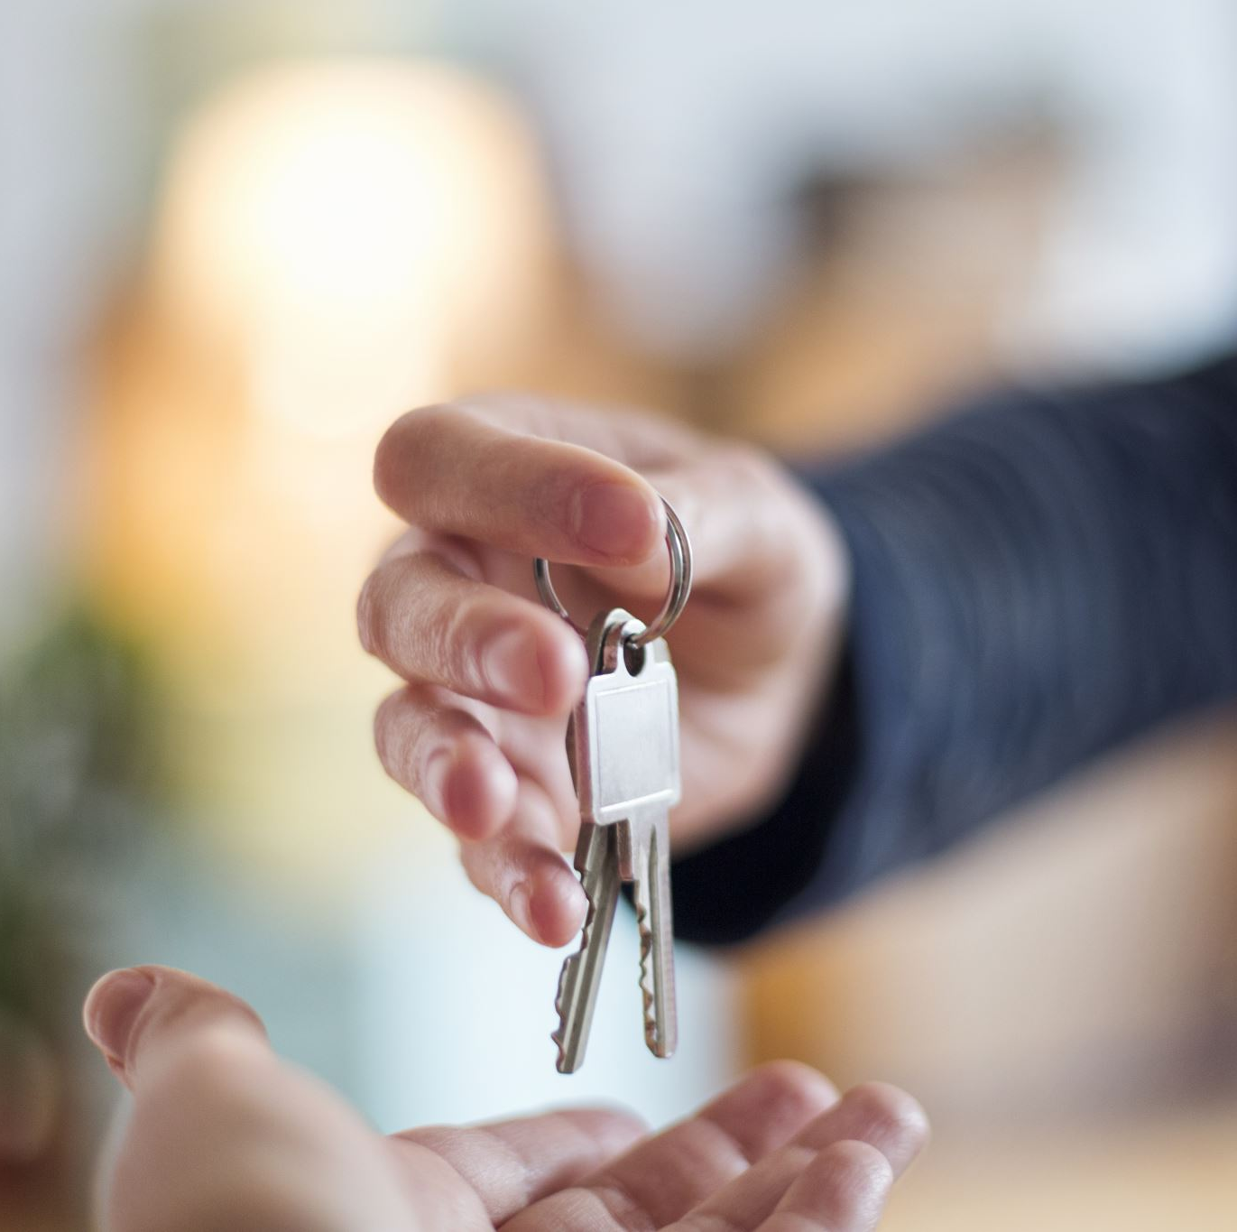
Current state of ethics
Legal model
Risk driven
We are stuck here

Slide 34
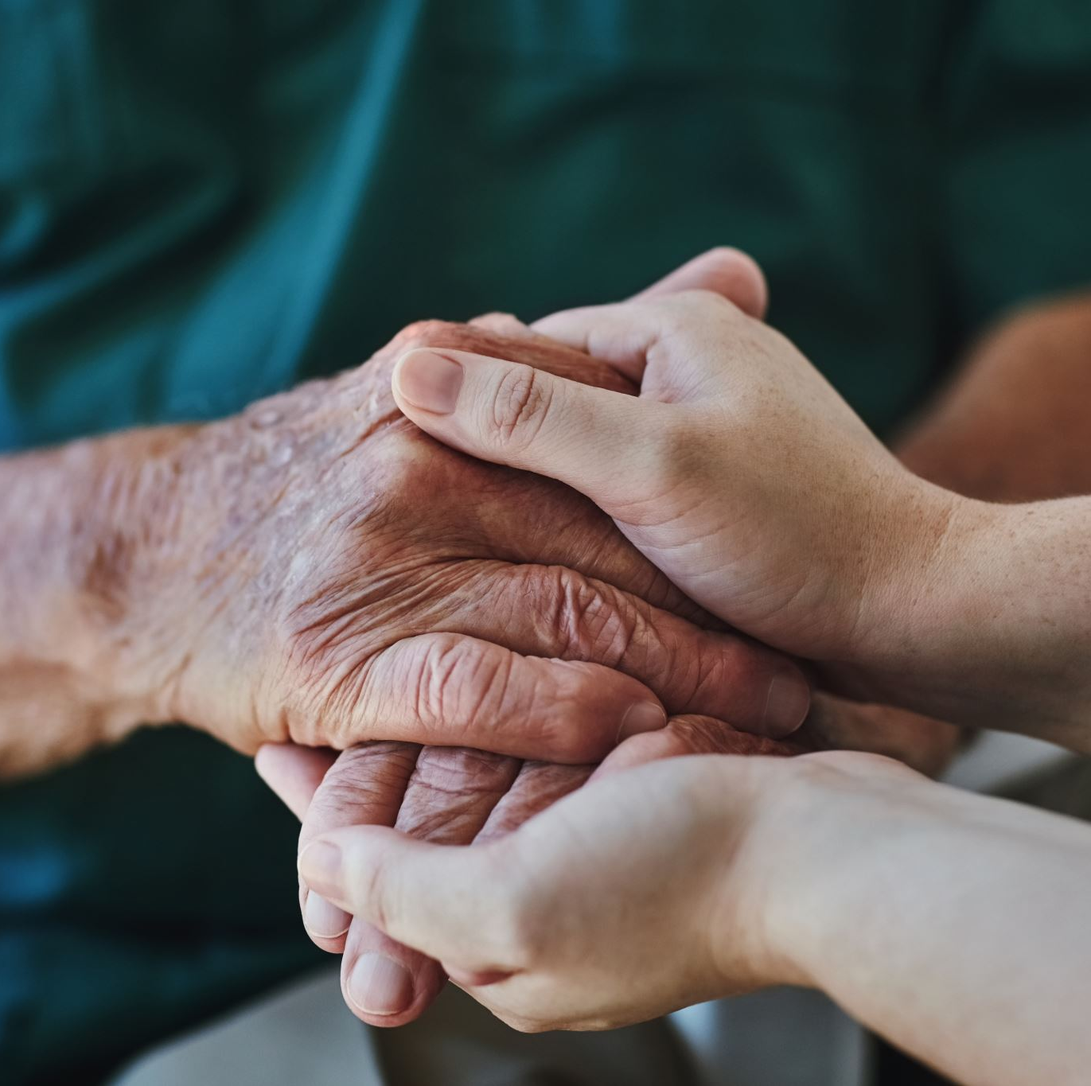
Frameworks
Ethics
Human Rights
Law
Notes:
https://www.jstor.org/stable/pdf/j.ctvhrd092.18.pdf?refreqid=excelsior%3Ad4a9bd96bfd773bc38dbc3637ecdbfb4

Slide 35
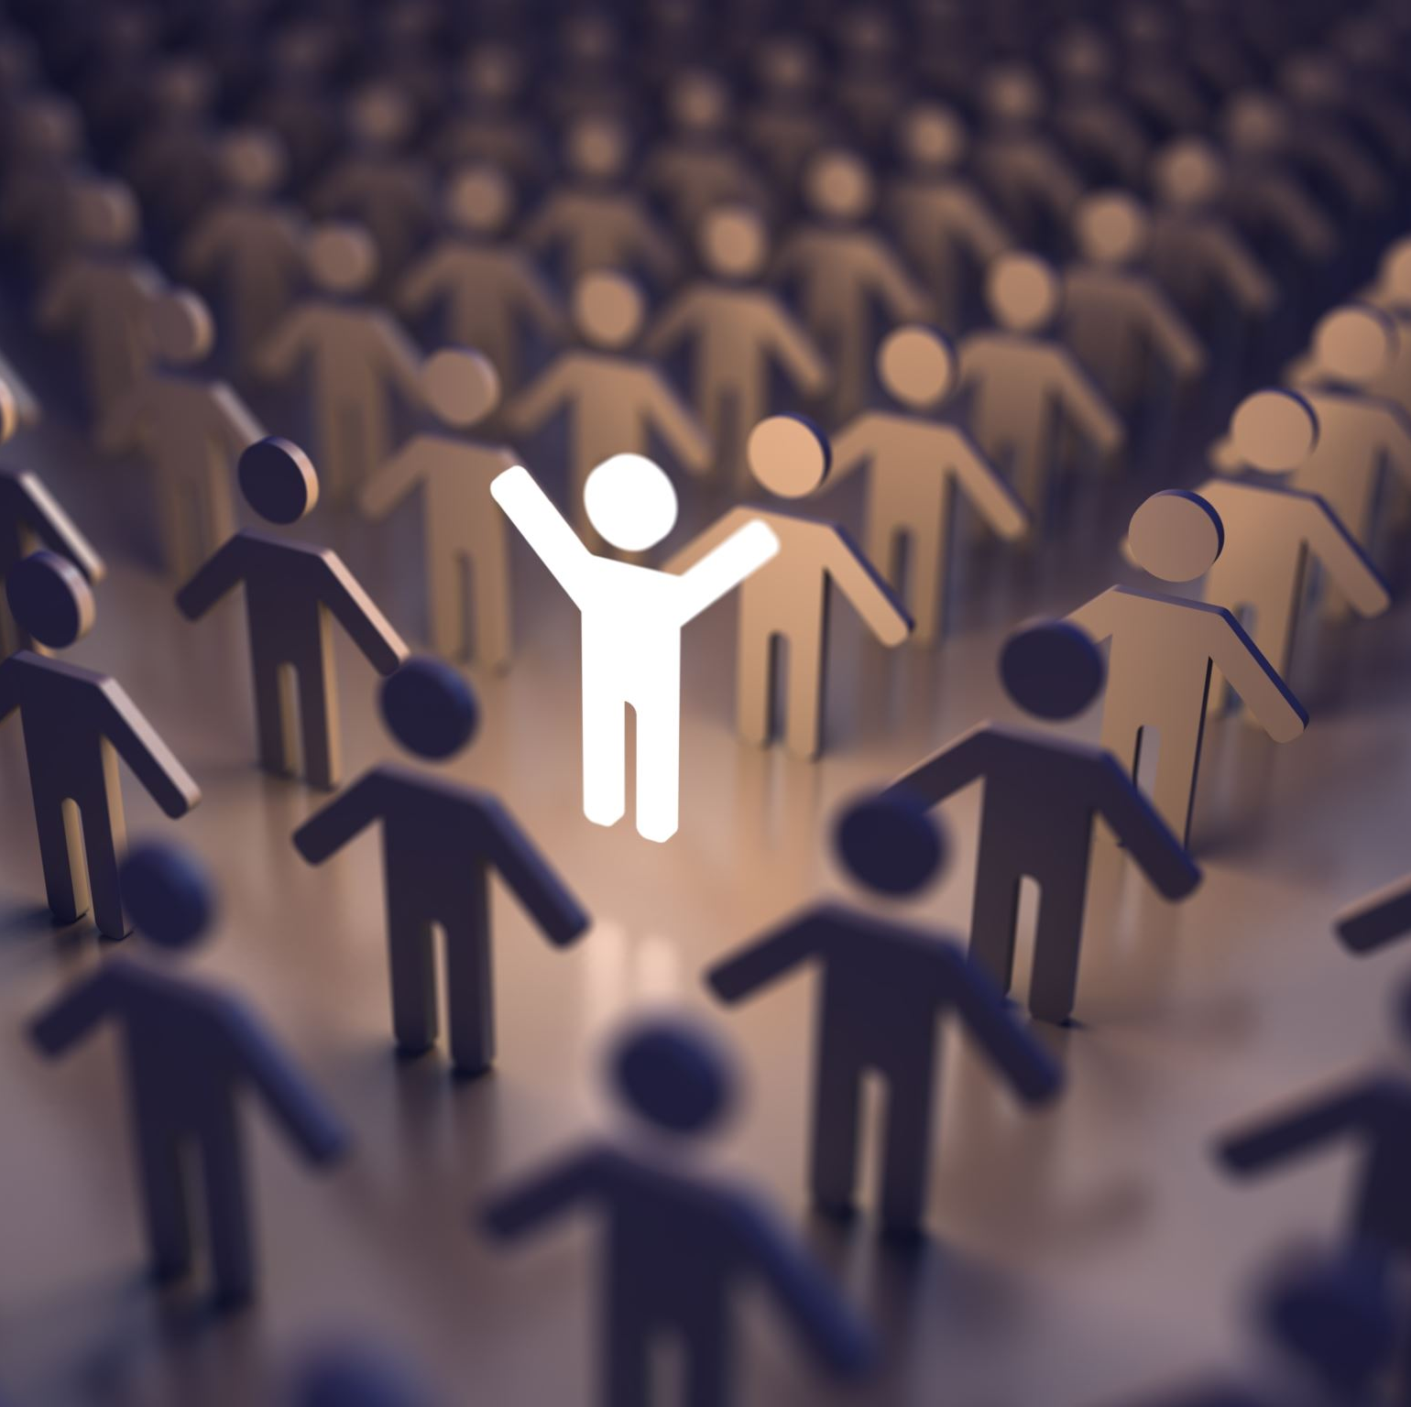
Faith and belief
opportunity to deeply explore the role of faith communities in AI stewardship
an area where collective ethical reflection and community involvement are crucial

Slide 36
Ethical Frameworks: 4 basic categories
We should do good
Minimise harm
Respect human autonomy
Be just or fair

Slide 37
Concerns (IT perspective)
Data governance – where does your data go?
Is the data used to train AI?
Do they meet standards of information security?
How do you address bias?
How do you make AI transparent and responsible?

Slide 38
Questions
Are current accessibility standards sufficient for AI?
How does our legislation have to change to include AI?
What do we involve our communities in thinking about AI?
How do ethics, rights and legislation connect?
What does AI have to do to be more inclusive?
Is an ethical framework sufficient?

Slide 39
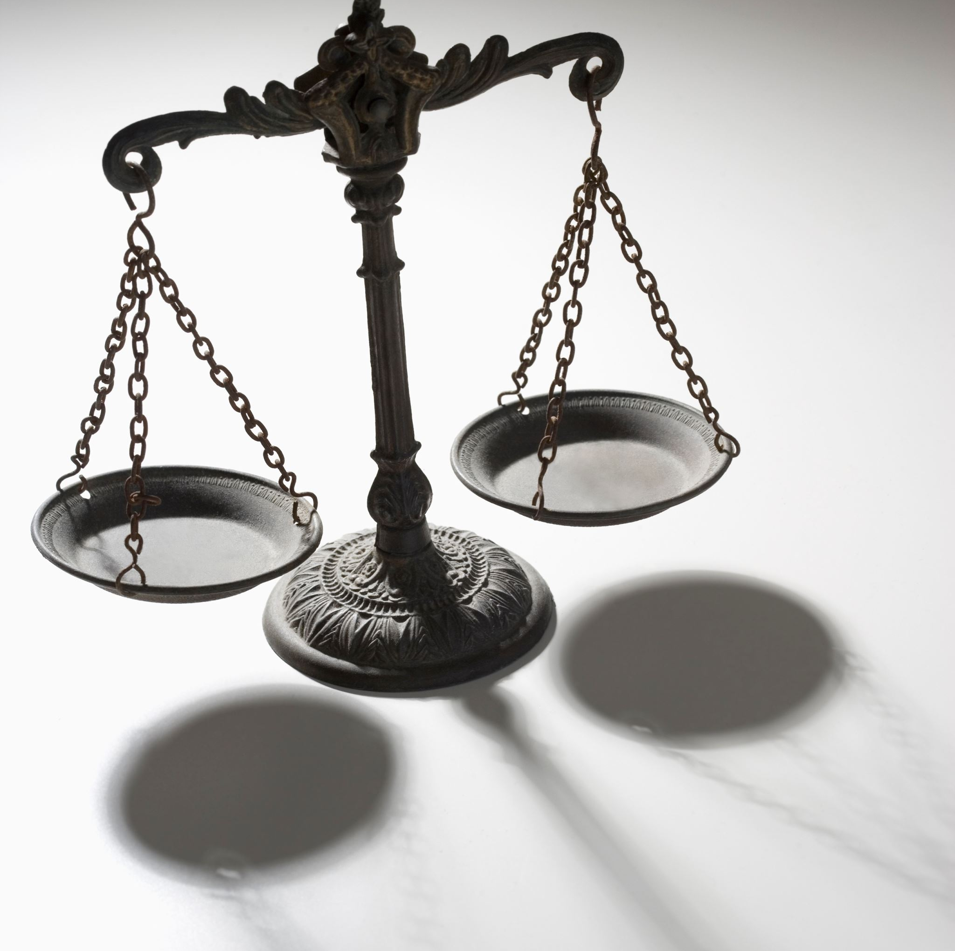
Summary
Ethics committees
Disability and AI
Religion and belief and AI
Legislation and ethics
Questions
Notes:
“Trustworthy, ethical and inclusive”

