Slide 1


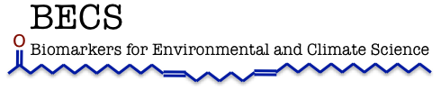
Preservation and Detection of Molecular Signatures of Life under Mars-Analogue Conditions
Nick Thomas

Slide 2
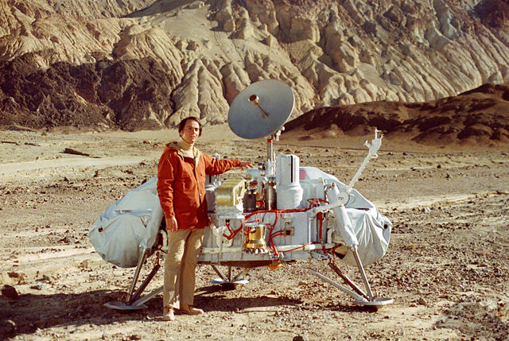
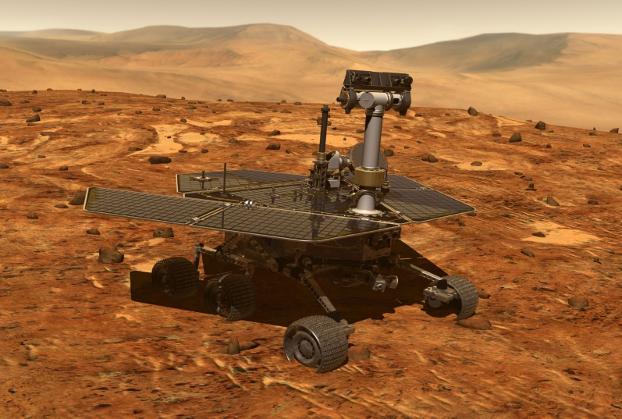
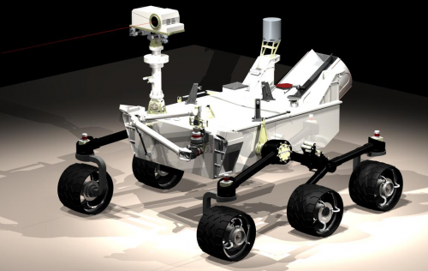
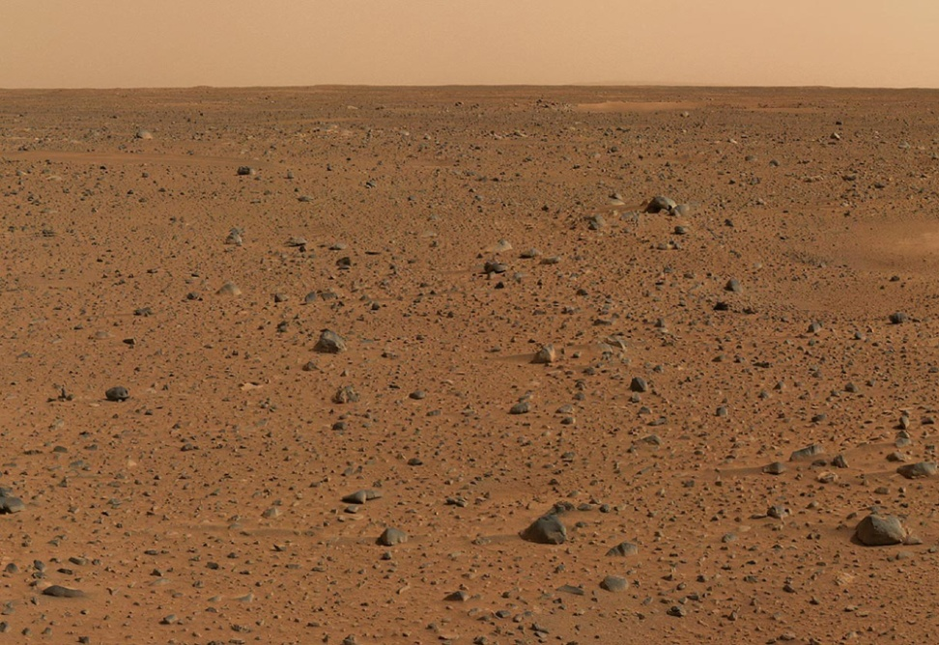
Life on Mars?

Slide 3
Biomarkers
AKA Molecular Fossils
Organic molecules
Organic derivatives
Remain stably intact in the environment for extended periods
Distinct from inorganic/mineralogical compounds
Examples are Nucleic Acids, Membrane Lipids, derivatives of photopigments

Slide 4
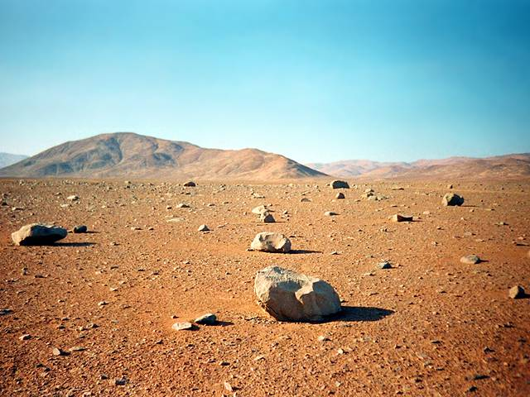
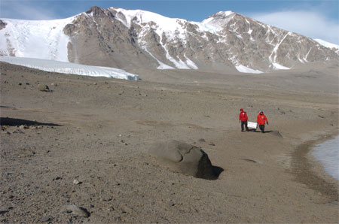
Terrestrial Analogues
Atacama Desert, Chile
McMurdo Dry Valleys, Antarctica

Slide 5
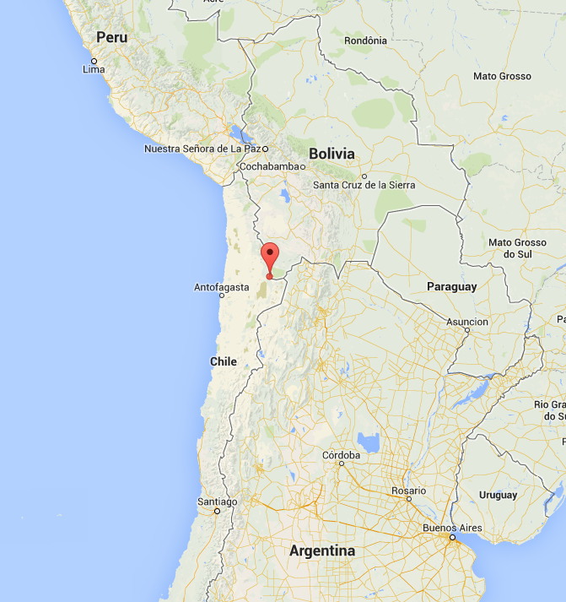
Sairécabur Volcanic Group
3 sites centred around Cerro Sairécabur.
Site A
  S 22.72 W 67.91
  5282m
Site B
  S 22.72 W 67.90
  5432m
Site D
  S 22.67 W 67.95
  4294m

Slide 6
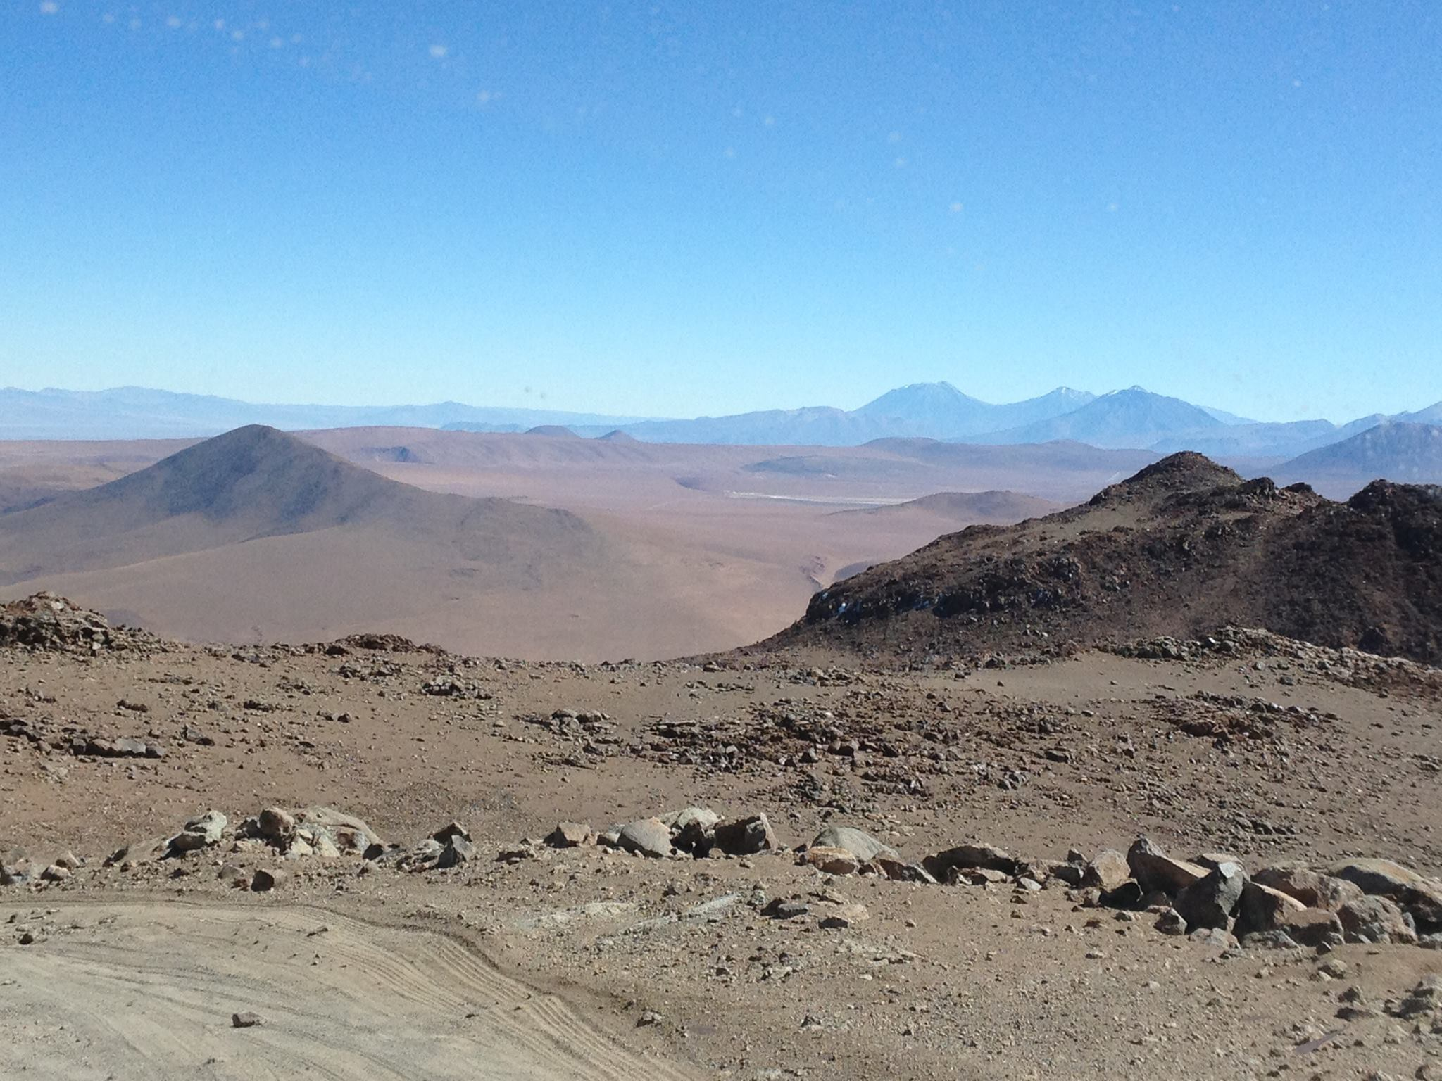
View From 5500m

Slide 7
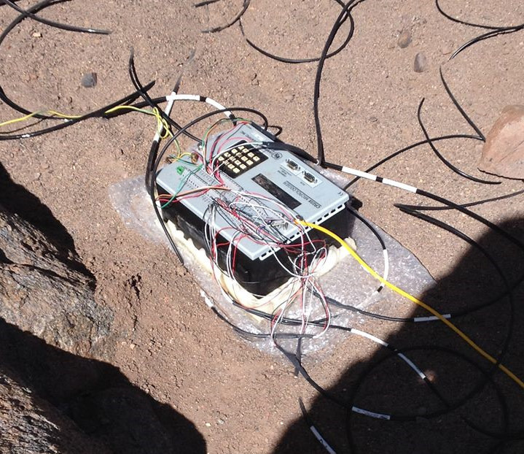
Environmental Data

Slide 8
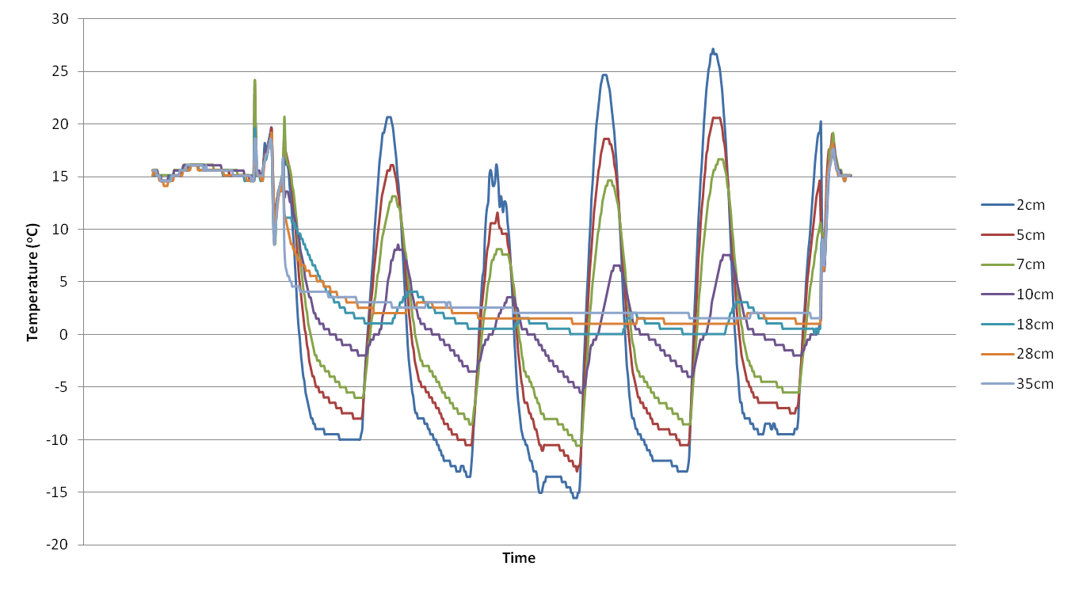
iButton Temperature Data

Slide 9
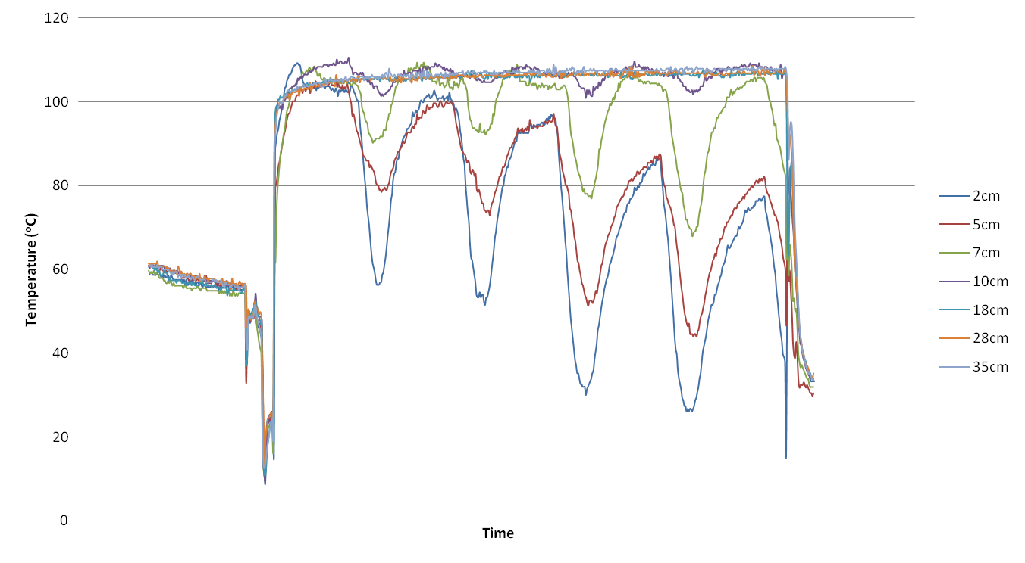
iButton Humidity Data

Slide 10
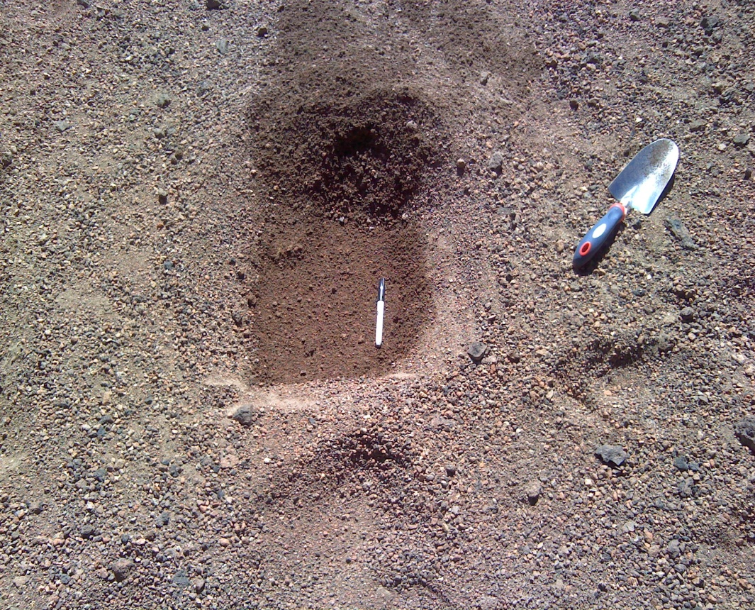
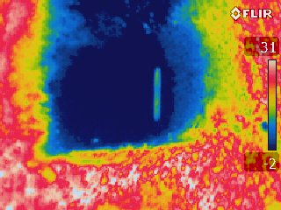
Thermal Imaging
7cm-deep hole, imaged immediately following excavation

Slide 11
DNA Concentration – Site A
Site A (5282m)
Depth (cm) | [DNA] (ng/mL)
0 | 0.82
1 | 0.99
3 | 1.06
7 | 7.56
15 | 13.1
38 | 3.31

Slide 12
DNA Concentration – Site B
Site B (5432m)
Depth (cm) | [DNA] (ng/mL)
0 | 1.03
1 | 1.01
3 | 1.79
7 | 6.73
17 | 9.57

Slide 13
DNA Concentration – Site D
Site D (4294m)
Depth (cm) | [DNA] (ng/mL)
0 | 12.9
1 | 31.3
3 | 55.2
7 | 26.6
15 | 216.0
37 | 25.9

Slide 14
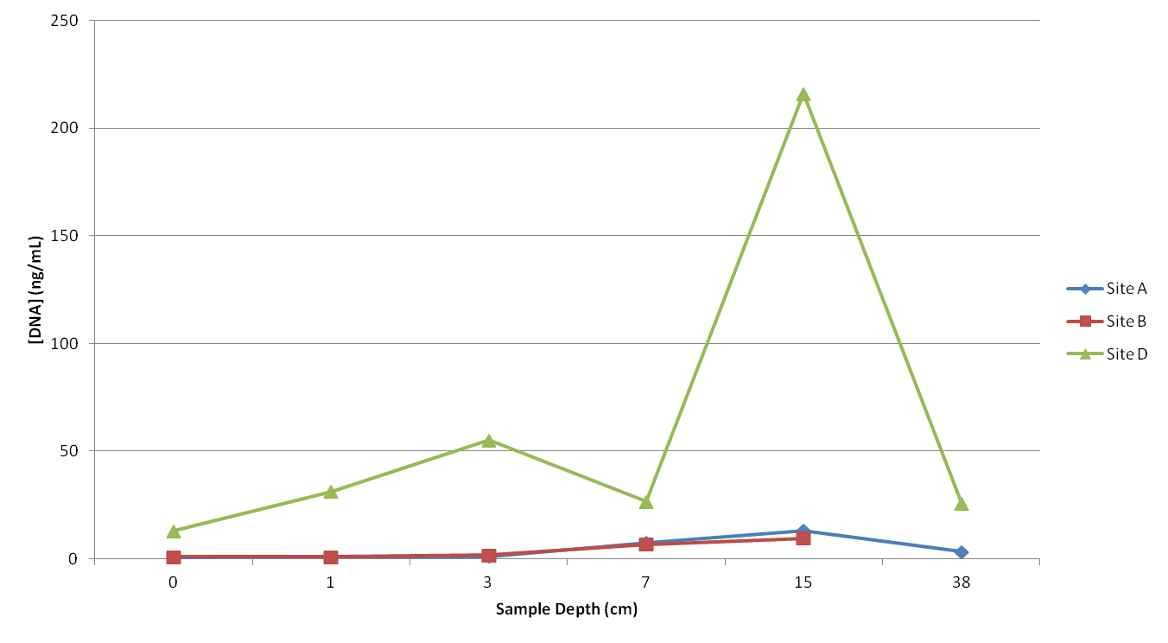
DNA Concentration

Slide 15
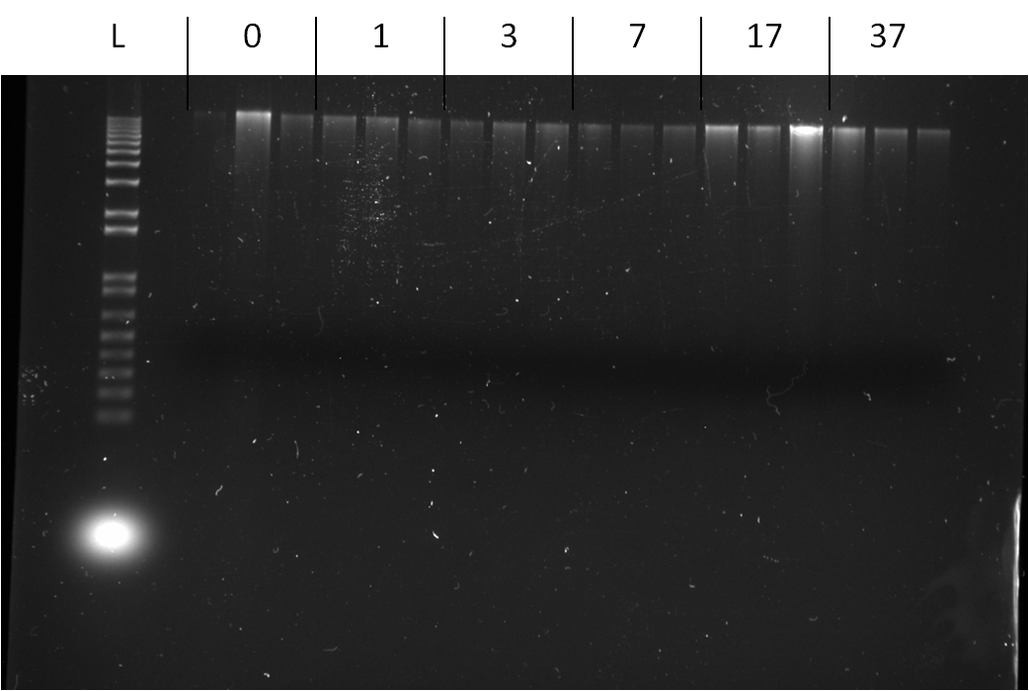
DNA Concentration
DNA labelled with fluorescent dye
Imaged under UV light
Brightness of bands indicates concentration of DNA in well
Gel photograph example: Site D Extracts

Slide 16
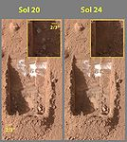
Implications
Altiplano as an analogue
Low Temperatures
Instability of Liquid Water
High Solar Flux
Shallow Subsurface Ice
Preservation of DNA at depth

Slide 17
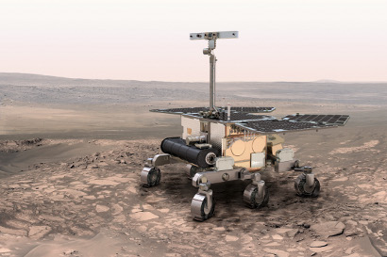
What’s Next?
Extracted DNA 16S Amplicon Sequencing
Lipid biomarker extraction and characterisation
Raman Spectroscopy focus on organic compounds
ExoMars Rover 2018

