Slide 1
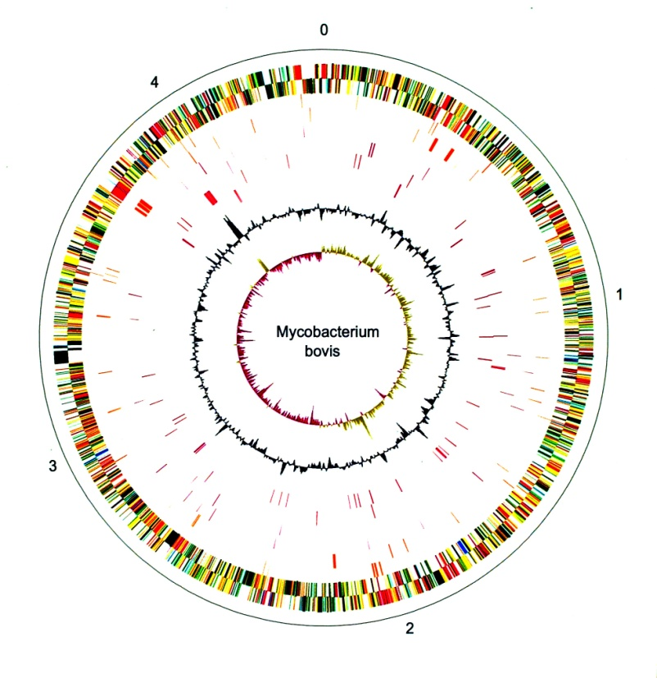
Stephen Gordon, UCD
Research Interests
  Virulence mechanisms of
  M. bovis
  Molecular basis of host preference in M. tuberculosis complex
  [M. paratuberculosis: novel diagnostics]
Aims for the workshop
  Current status of NGS as applied to bTB
  Insights in host-pathogen interface?
  Real-time control tool?

