Slide 1
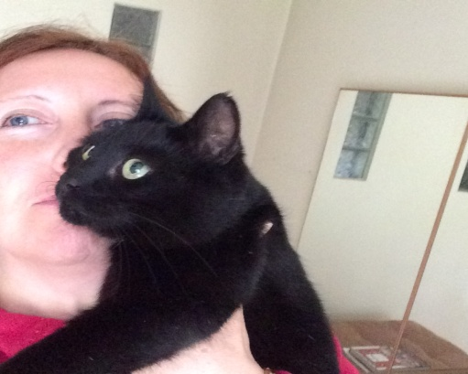
Angela Lahuerta, VRO@AFBI, Belfast
PhD on the interface of domestic animals and wildlife- molecular techniques were essential
Veterinary epidemiologist with special interest in zoonotic bacteria, disease control and surveillance
Still very “Naive” about bTB- PI on large project on the evaluation of bTB diagnostic methods performance
PI with Dr. Andrew Byrne on project on the impact of concurrent infections on bTB disclosure in cattle (Johne’s, BVD and Liver Fluke)
Expectations from Workshop : increase my knowledge on current molecular techniques to characterise bTB – “big picture on the bTB epidemiology”, new hosts, disease dynamics; further applications to other zoonoses?

