Slide 1
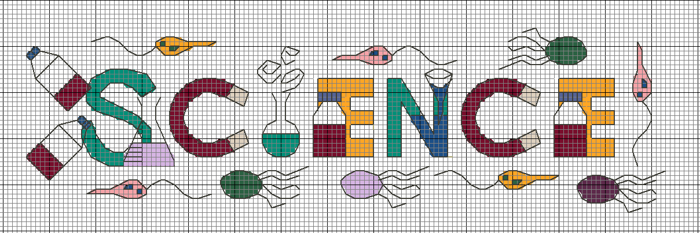


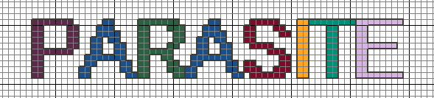
in Stitches
Cross Stitch
Learn all about parasites through cross stitching!

Slide 2
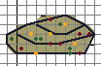
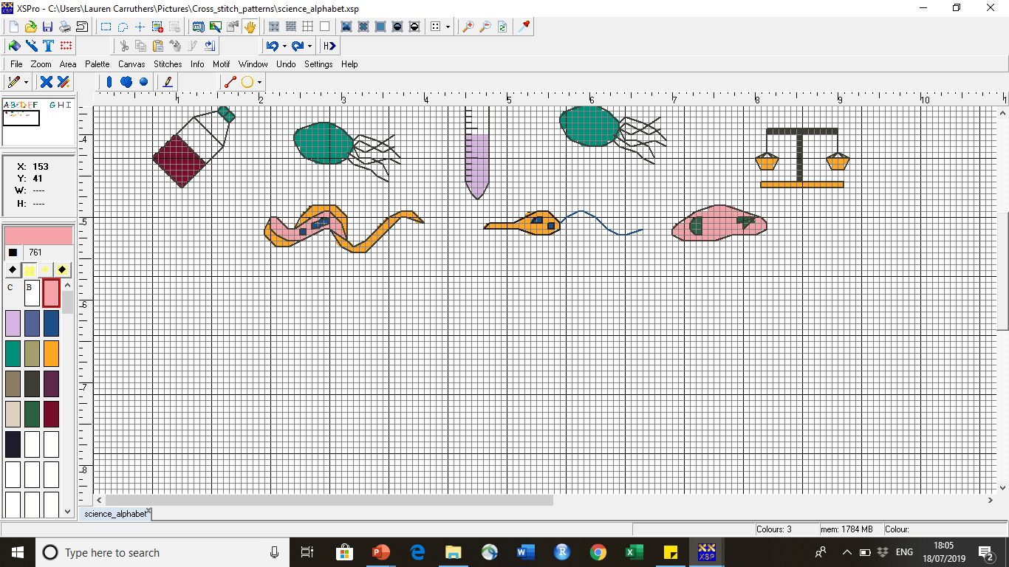
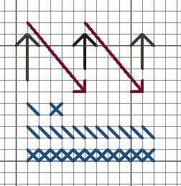
Dots represent either small 3D / French knots or beads
Cross Stitching Basics
Coloured squares are crosses in two strands of embroidery thread
How to cross stitch:
Secure the thread on the back of the aida fabric by looping the thread through several times or tying a small secure knot to attach the thread to the aida fabric.
To stitch the squares, loop the needle diagonally across the square into the diagonally opposite hole. Do a straight stitch behind to the hole directly above and them loop the needle in the other diagonal direction to form a cross.
You can do one cross at a time but it is easier to do runs of diagonals in a row in one direction and then back track in the other direction.
French knots are small 3D knots alternatively thread a small bead on to the thread and pull tightly.
To finish, loop the thread through your previous stitching at the back or gently knot to secure the thread and prevent your work coming undone.
Each square represents one cross
Lines are backstitches. You can do these with one or two strands of thread
Equipment
Needle
Embroidery threads of different colours
Aida fabric
Black straight arrows: thread the needle and thread behind.
Red diagonal arrows: thread the needles and thread across over the front.

Slide 3
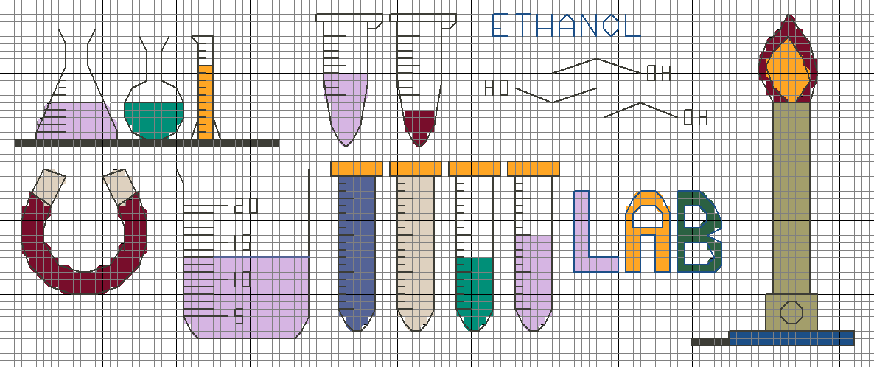
Round-Bottomed Flask
Microcentrifuge Tubes
Science Equipment
Conical Flask
Measuring Cylinder
Ethanol
Magnet
Beaker
Falcon Tubes
Bunsen Burner

Slide 4
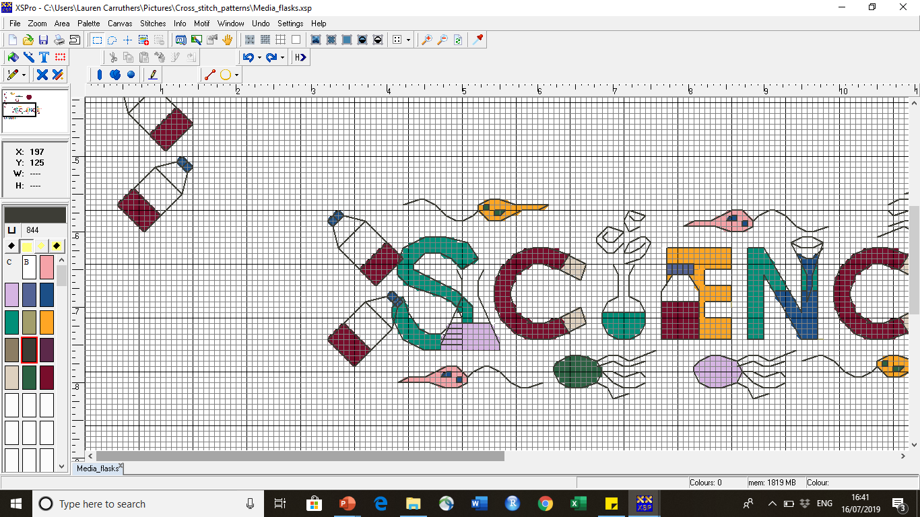
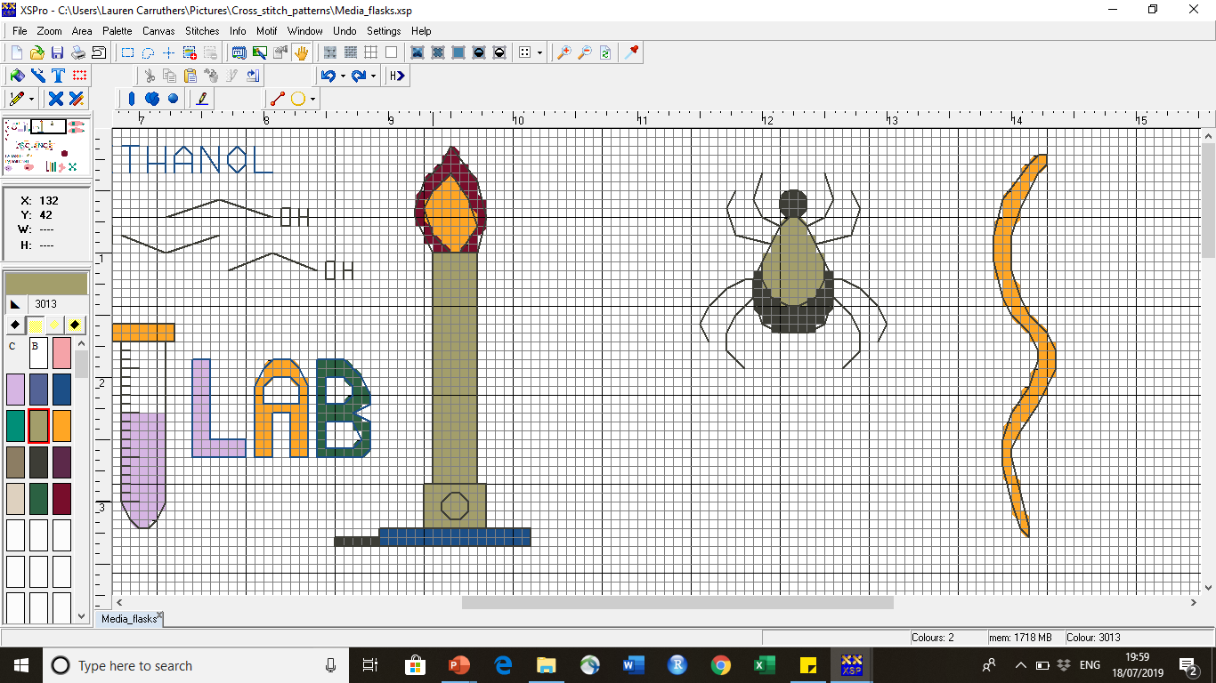
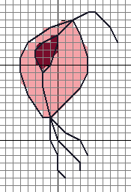
Toxoplasma
Leishmania
Trypanosoma
What is a
?
Ascaris
Tick
Trichomonas
A parasite is an organism that lives in or on another organism. Parasites usually benefit by stealing nutrients from their host and give nothing in return. Parasites can infect humans, animals and plants. They can be microscopic in size and consist of one cell, such as Leishmania, or they can be made up of lots and lots of cells and be several metres in length, such as tapeworms. Some parasites are very simple and some are very complex, with multiple different life cycle formations. Parasites cause lots of different diseases such as malaria, sleeping sickness, toxoplasmosis and giardiasis. The diseases range in severity: you may never know you harbour a parasite and live with it in harmony all your life, or they can kill you. There is evidence to suggest that some parasites may not be so bad after all.
At the Wellcome Centre for Integrative Parasitology (WCIP), University of Glasgow, scientists study various parasites to learn more about parasite biology, disease intervention and molecular epidemiology. Our mission is to develop a deeper understanding of parasites in order to develop new disease therapies and prevention strategies.

Slide 5
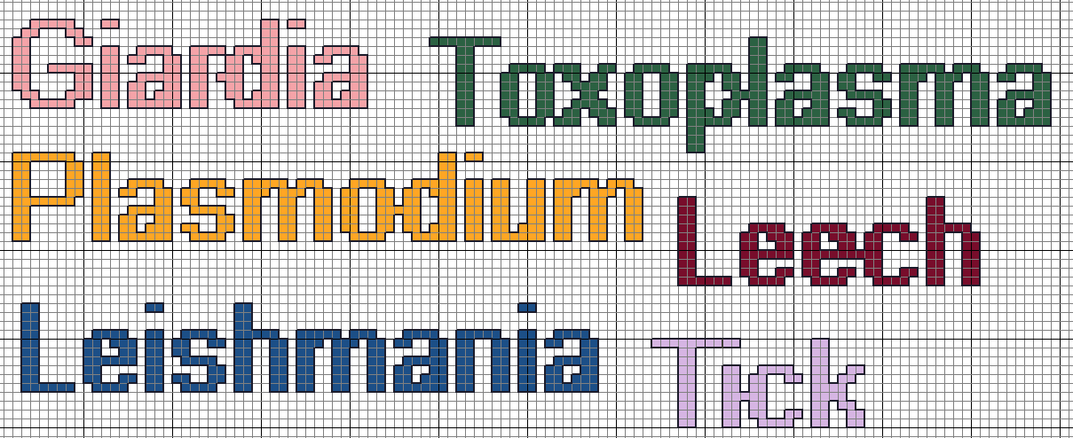
Plasmodium is the parasite which causes the disease malaria
Toxoplasma is spread through contaminated cat faeces or by eating undercooked infected meat. Most people never know they are infected
An infection with Giardia could leave you chronic diarrhoea
A parasite that sucks your blood and can transmit infections to you such as Lyme’s disease.
There are several species of Leishmania, some will cause skin ulcers, leaving scars for life, others infect your organs and can kill you
Blood sucker

Slide 6
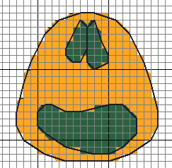
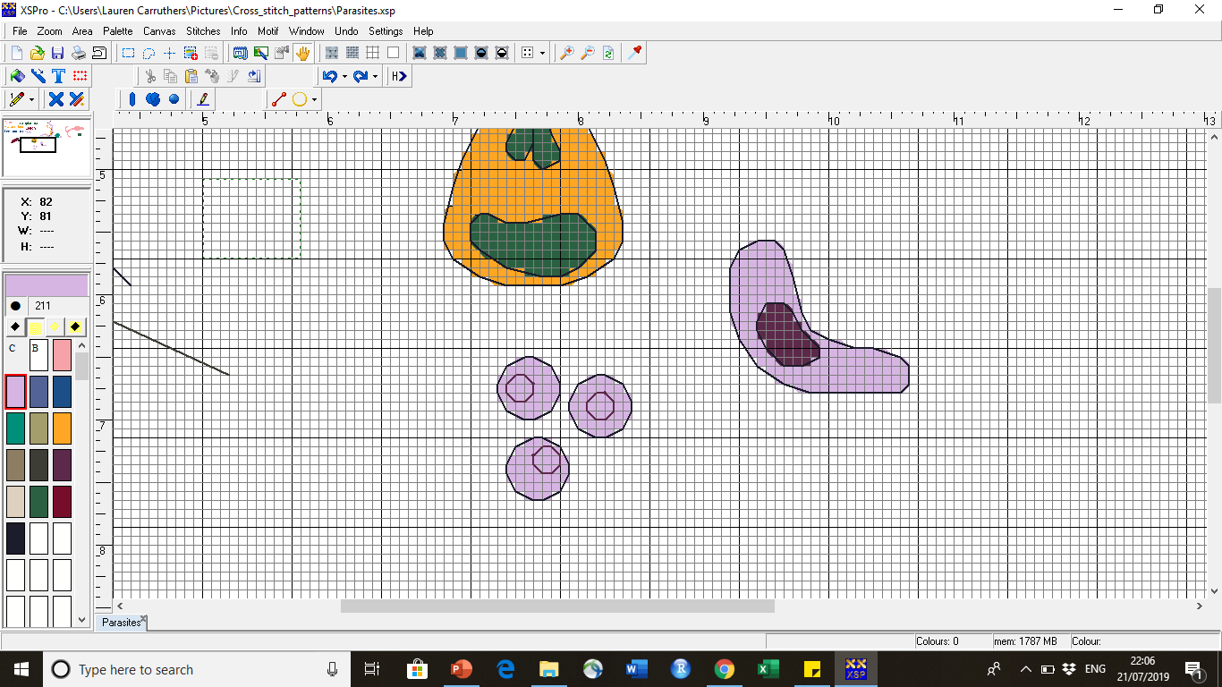
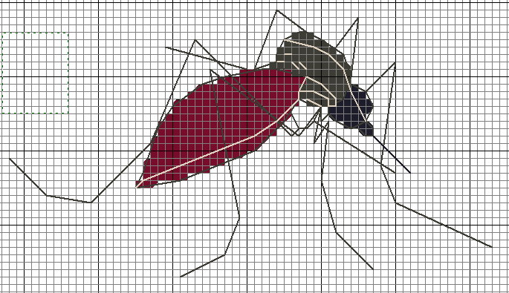
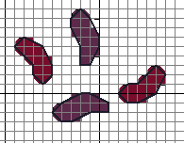
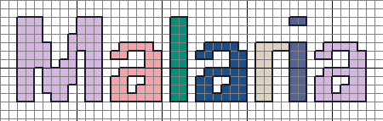
Plasmodium
Plasmodium parasites cause the disease malaria. The parasites are passed to humans when an infected female mosquito takes a blood meal and injects Plasmodium parasites into the blood stream. Plasmodium is the greatest human parasitic killer and causes many more people to be unwell. Due to illness it also causes economic and social burden particularly in developing tropical countries. Taking anti-malarials when visiting at risk areas, can help to prevent disease if you are bitten by an infected mosquito. Bite prevention is however, better than infection cure. Sleeping under mosquito bednets, wearing long, lighter coloured clothing and putting on mosquito repellent can all help minimise your chances of being bitten by mosquitoes and getting malaria as well as other mosquito borne diseases.
Plasmodium Ring stage
Mosquito
Plasmodium Gametocytes
Plasmodium Merozoite
Plasmodium Ookinete

Slide 7
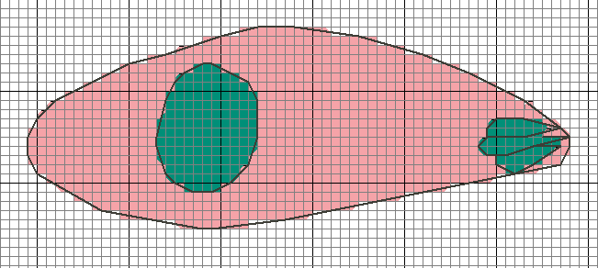
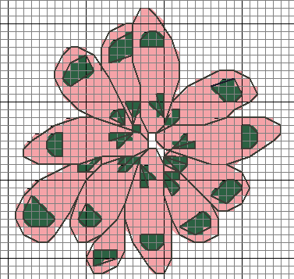
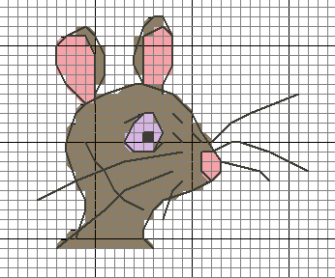
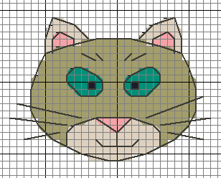
Toxoplasma
Toxoplasma is spread from mice to cats but can be passed to humans by ingesting contaminated cat poo by accident (so wash your hands after changing cat litter trays and or contact with soil) or eating undercooked meat that contains Toxoplasma cysts. The parasite is very adaptable and can infect most mammals including lions, zebras and giraffes.
Toxoplasma gondii is a parasite that is thought to infect around 30% of the human population. Most of us will never even know we are infected. In individuals with weakened immune systems Toxoplasma can become a killer. The parasite can also cause problems to the unborn child if the parasite infects a pregnant woman.
Cat eats mouse
Toxoplasma:
A game of cat and mouse
Mouse ingests cat poo

Slide 8
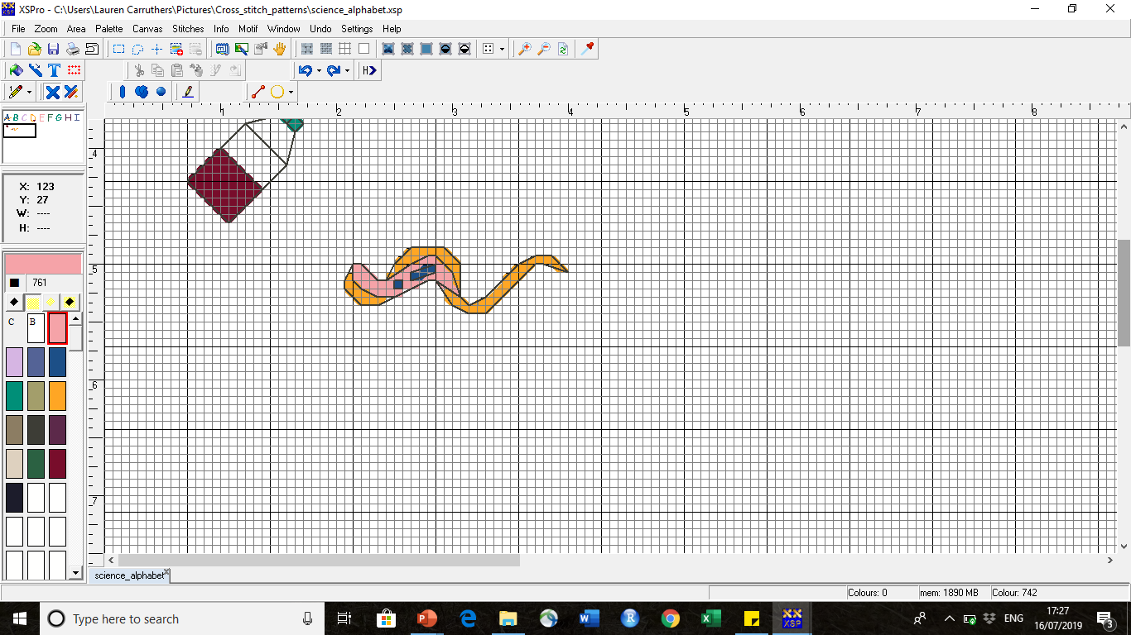
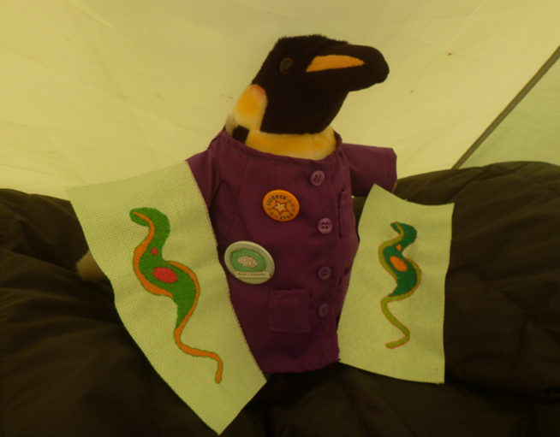
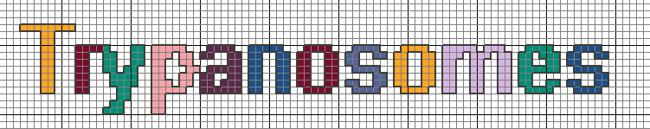
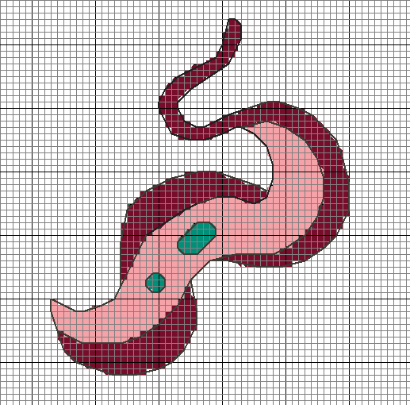
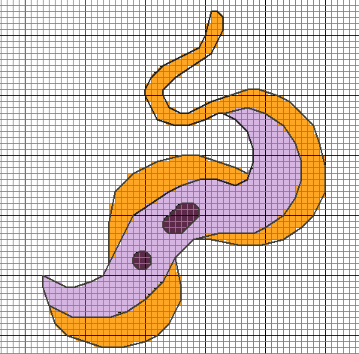
Trypanosoma
Meet Henry the Science Penguin who is on a mission to simplify science, make science more inclusive , and inspire the next generation. Follow him on twitter @henry_science
Trypanosomes can undergo a process where they can switch their disguise so they become unrecognisable to our immune system. By the time our immune system realise the invader has changed form the parasite has already taken on another outfit. This process of outfit disguise switching is called antigenic variation. Plasmodium and Leishmania can also use this process to help escape our immune cell police.
Trypanosomes are single cell microscopic parasites. In sub-Saharan Africa they cause a deadly disease in humans called Sleeping Sickness also known as Human African Trypanosomiasis. The species that causes this disease is Trypanosoma brucei and it is transmitted to humans through the bite of an infected tsetse fly. Trypanosomes can also cause disease in cattle and other animals. In South America, Trypanosoma cruzi causes Chagas Disease in humans which can cause heart failure many years after the parasite infects you. Trypanosoma cruzi is transmitted through the faeces of a triatomine bug, otherwise known as the kissing bug. The tale of the kissing bug is not very romantic however, because after they bite you, you itch the bite site and rub bug poop into the bite wound which may contain deadly parasites.

Slide 9
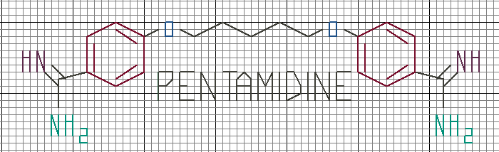
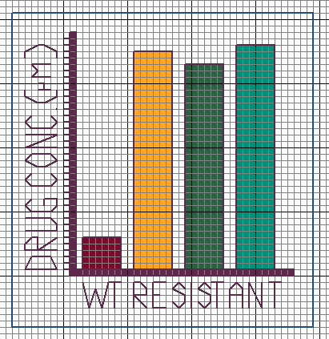
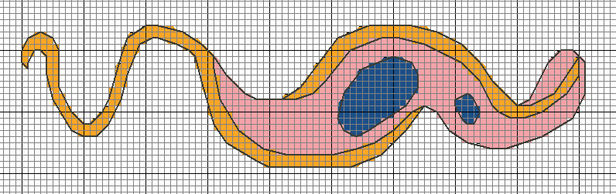
The drugs to treat trypanosomiasis are not very nice because they are highly toxic. Trypanosomes have also become resistant to some of the drugs so they no longer work. Since trypanosomiasis is usually deadly without drugs, it is important that new and safer drugs are discovered to treat trypanosome diseases. At the WCIP, scientists are learning more about trypanosome biology and are involved in drug discovery programmes testing new drugs to help find new cures to fight this disease.
Chemical structural formula of the anti-trypanosomal drug pentamidine
Nucleus
Kinetoplast
Flagellum

Slide 10
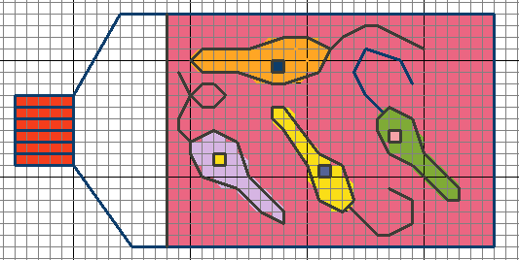
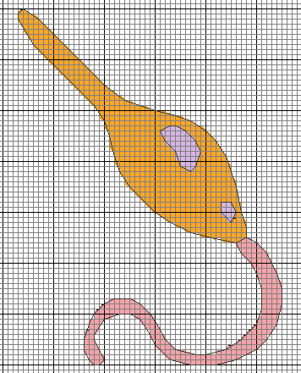
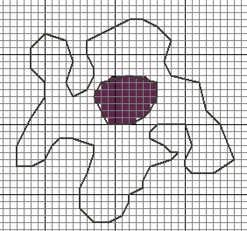
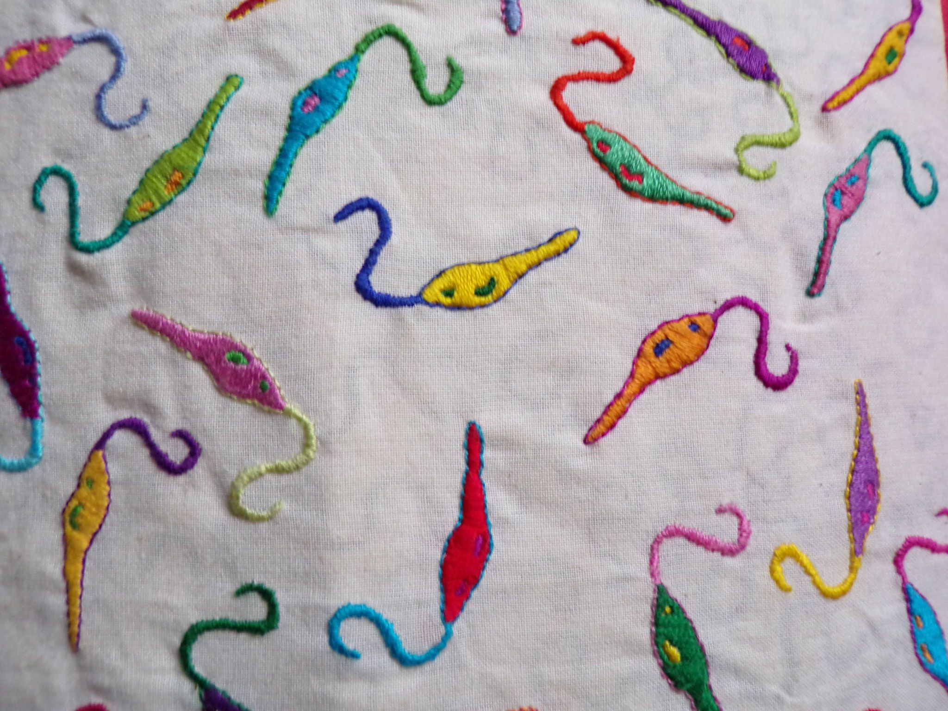
Leishmania
Leishmania parasites are transmitted by sandflies and cause a disease called leishmaniasis in humans and animals. The disease is found in the Middle East, Central and South America, Asia and around the Mediterranean. There are several forms of the disease from the formation of skin lesions that leave permanent scarring, through to mucocutaneous manifestations where mucosal tissues such as the nose are destroyed, to infection of internal organs that can lead to death.
Leishmania parasites are related to trypanosomes and also undergo antigenic variation.
You can try sewing parasites using different techniques such as embroidery.
Leishmania parasites can infect white blood cells called macrophages.

Slide 11

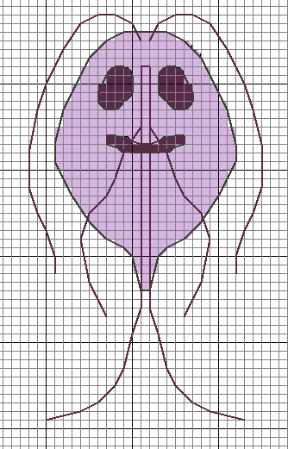
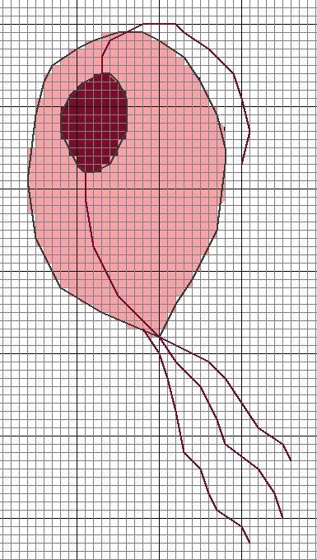
Trichomonas
Babesia
Giardia
Babesia parasites infect and destroy red blood cells. Some people do not experience any symptoms whilst others may generally feel unwell with non-specific symptoms. In individuals who have a weakened immune system the parasite can be deadly. Babesia is transmitted to humans and mammals through an infected tick bite
Trichomonas is a sexually transmitted parasite and a very undesirable Valentine’s day gift. The majority of infected individuals do not know they are infected. In some individuals it causes discomfort whilst urinating and irritation to the genital areas.
This parasite might look like it has a smiling, friendly face, but do not be deceived! Giardia will ensure you endure explosive diarrhoea if it infects you during your travels. Be sure to wash and cook your food well and drink filtered, boiled or bottled water. Wash your hands well too before eating. This tiny parasite is spread by contaminated faeces and poor sanitation and can also survive chlorine so swimming whilst infected is a no!

Slide 12
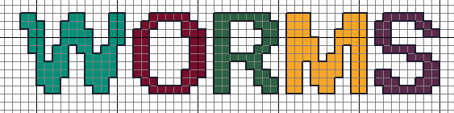
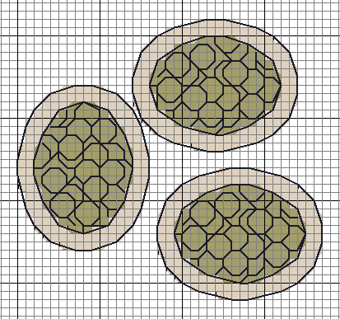
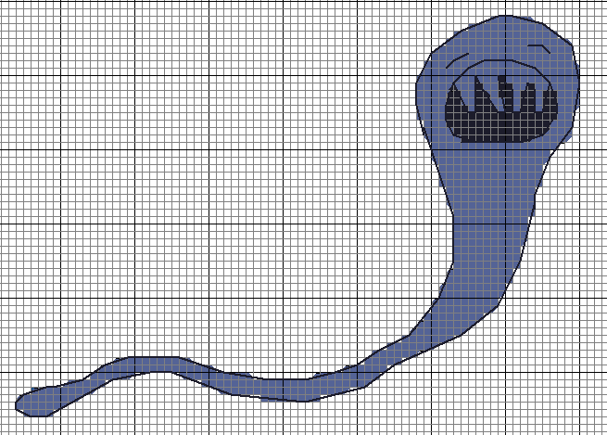
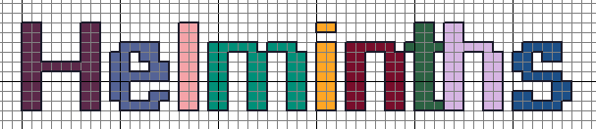
Worm Parasites (Helminths)
Helminths are parasitic worms. There are many different types that infect humans and animals (including pets and livestock). Parasitic worms often have complex life cycles with multiple life cycle stages. Worm infections are often considered detrimental to health. Heavy burdens of multiple different species can cause reduced growth, malnutrition, anaemia and can lead to death. The heaviest human worm burdens are found in tropical countries however, worm infections can be found globally. Worm infections are a cause of economic burden due to missing work due to illness or to loss of infected livestock.
Infected
Poo
Hookworm (Necator americanus and Ancyclostoma duodenale) infect humans when the larval form of the parasite burrows through the skin, often through the sole of bare feet. The worm then matures and makes its way to the intestine where it feeds on human blood. The worms produce eggs which are passed out in human faeces. The eggs hatch out into larval worms and the life cycle begins again. Research is currently looking into therapeutic properties of hookworms as there is evidence to suggest that they may help resolve allergies and autoimmune diseases. Self infecting yourself with hookworm is not recommended!
Hookworm Eggs
Hookworm

Slide 13
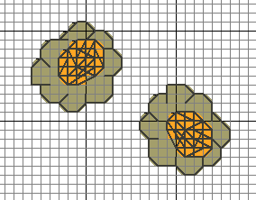
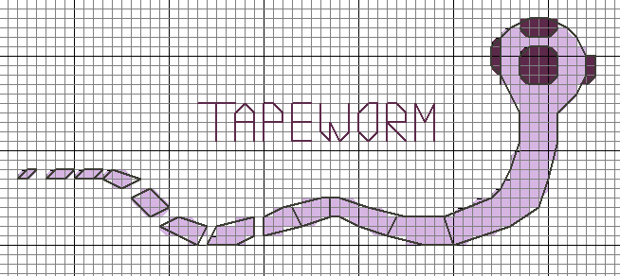
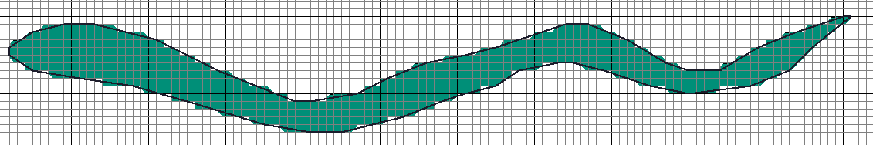
Tapeworm
Scolex which is used to suck human blood
Gravid proglottids
Ascaris Eggs
Ascaris lumbricoides is a roundworm. Humans become infected through the faecal – oral route. The adult worms mature and live in the intestine where they absorb nutrients.
Humans can become infected with tapeworms when they eat undercooked fish or meat. Once inside us, tapeworms can grow up to 25 m in length inside our intestines! Eggs or gravid proglottids containing eggs are excreted in human faeces and ingested by livestock and the cycle repeats itself again. Tapeworms can also autoinfect humans meaning they can hatch out in the intestines so if you are infected by one worm it could result in being infected by many tapeworms!
Ascaris lumbricoides

Slide 14
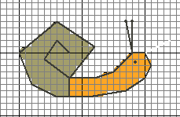
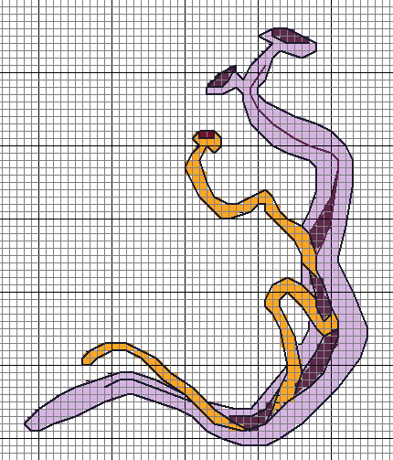
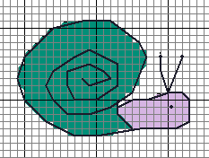
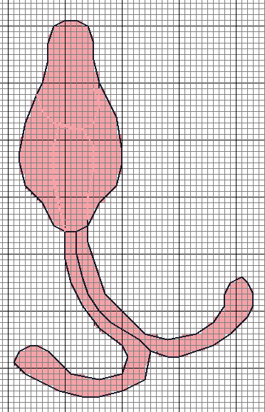
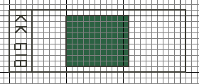
Schistosomiasis
Schistosomiasis, also known as bilharzia or snail fever, is a parasitic worm infection with several life cycle stages. Individuals become infected when the cercarial stage of the schistosome parasite burrows through the skin when an individual comes into contact with water contaminated with the cercarial forms.
Adult schistosome worms
Snails are intermediate schistosome parasite hosts.
Male
Cercarial stage
Female
Kato-Katz microscopy slides are one method used to test to see if an individual has schistosomiasis. The technique allows scientists to detect parasite eggs present in poo.

Slide 15
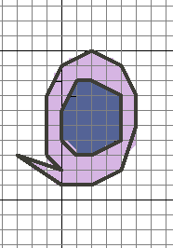
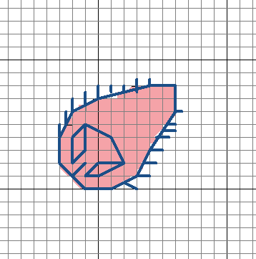
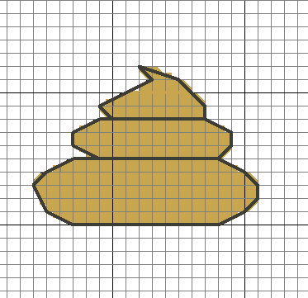
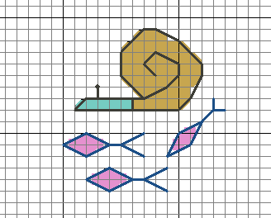
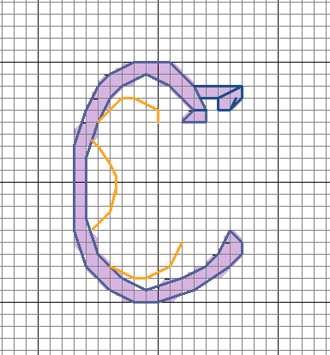

Schistosoma mansoni
Life Cycle
In freshwater, the eggs hatch into the miracidia stage
The miracidia then infect intermediate snail hosts (Biomphalaria species) and multiply
Miracidia
Eggs
Cercariae
Adult male and female worms pair up and the female worms lays lots of eggs which are passed out in the faeces
Adult Female
When humans make contact with cercariae infected water, the cercariae penetrate through the skin, lose their tail and enter the bloodstream. They then mature into adult schistosome worms which takes about a month
Snails release hundreds of thousands of human infective cercariae into freshwater
Adult Male

Slide 16




Heligmosomoides polygyrus
Mouse
H. Polygyrus adult worm
Heligmosomoides polygyrus is an intestinal mouse worm infection. It can be used as a model in research to help scientists learn about more about parasitic worm infections. Scientists are also research properties of Heligmosomoides polygyrus that are able to dampen down out of control immune responses. It is hoped that we will be able to isolate these chemical properties in the future and use them to help prevent and control allergic and autoimmune responses to self tissues.
Culture flasks of
H. polygyrus worms
H. Polygyrus worms

Slide 17








Culture flasks
Lab coat
DNA
Medicine
Microscope
Pipette
Antibodies and Antigens

Slide 18



Slide 19



Slide 20



Slide 21


Slide 22

Why not try making your own science designs here?

Slide 23




The cross stitch patterns were created by Lauren Carruthers who is a final year PhD student studying interactions between schistosome parasites, gut bacteria and anti-worm drugs at the WCIP in Glasgow. Some of the designs are based on the WCIP parasite comics.
Want to learn more? Check out our parasite comics here:
Toxoplasmosis: https://www.gla.ac.uk/media/media_525175_en.pdf
Malaria: http://malariacomic.co.uk/
Trypanosomiasis: https://www.gla.ac.uk/media/media_461228_en.pdf
Parasites: https://www.gla.ac.uk/media/media_511045_en.pdf
Creative Ideas:
Make some science themed cards
Decorate a t-shirt
Decorate a lab coat
Make a bookmark
Make a cushion
Make a science sampler
Make some educational sewn resources
Make some parasite decorations
Create an infectious quilt
Decorate a towel
Decorate a pillow case
We would love to see your science stitching creations. Tag your photos on twitter @ParasiteStitches #ParasiteStitches and follow our page for more patterns and updates. If you have any parasite or science questions, a design request or feedback about this Parasite Stitches booklet drop us a line and we’ll do our best to respond. Happy Sewing!

Slide 24
@WCIPGLASGOW
@lvcarruthers
@henry_science
#ParasiteStitches
@ParasiteStitches

